Slide 1
Classroom Activity – Fluid Power
Introduction to the History of Fluid Power
Compressibility of Fluids
Pascal’s Law
Relationship of Force, Pressure & Area
Solving a problem involving Force, Pressure & Area
Exploring a fluidic system
Building Activity – Up & Over model
Classes of Levers
Analysing a Fluid Power System

Slide 2
History of Fluid Power - 1
The word hydraulics comes from the Greek word Hudraulikos - hudor- meaning water and aulos – meaning pipe
In a dictionary you will ﬁnd a description such as the science of conveyance of liquids through pipes, especially as motive (motion) power
Modern uses of hydraulics reﬂect this well, hydraulic ﬂuid is pushed through pistons and pipes to do work
Early evidence of the understanding of the use of hydraulics was demonstrated by Leonardo de Vinci (1452- 1519) when he made sketches of simple hydraulic pumps, perhaps for printing presses

Slide 3
History of Fluid Power - 2
The French scientist Blaise Pascal (1623-1662) discovered the principles that govern the action of pressure on a surface.
Pascalʼs experiments in the mid 1600ʼs explained both hydraulics and pneumatics (which is somewhat similar to hydraulics, but uses air instead).
What he found was: “the pressure put upon an enclosed ﬂuid is transmitted equally in all directions without loss and acts with an equal intensity upon equal surfaces.”
It meant that the pressure you put on one piston, would be transferred equally to another one.

Slide 4
History of Fluid Power - 3
Joseph Bramah, a later scientist (1748-1814), put this theory into practical use, when he found that force applied in a small piston produced a greater force in a larger piston, but with less movement.
A great way to experience this is to ﬁll and put two different sized syringes or pistons together and press one at a time. It is easy to push the water from a small piston into a larger one, but much harder the other way!
Take out some pistons and try it!
Notes:
A kit of components is available containing 3 different sized syringes/pistons, 2 lengths of tubing and 1 “T” connector.
Cut 1 piece of tubing in half to make 2 X 6” pieces and 1 X 12” piece.

Slide 5
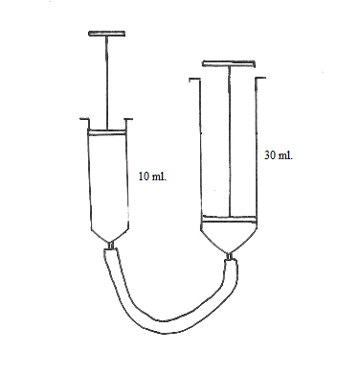
Compressibility of Fluids
Use a 30ml., a 10ml. piston and a short piece of tubing
Connect the tubing to the 30ml. piston
Push the plunger of the 10ml. piston in and then connect to the tubing
Pull the plunger of the 10ml. piston out and in and explore this pneumatic system
Notice that the 30ml. piston does not respond instantaneously because air is a “spongy” fluid and compresses – watch carefully as the delay is very slight!
Notes:
1: Explain the difference between solids, liquids, and gases in terms of density, using the particle theory of matter (e.g. in general, solids are more dense than liquids, which are more dense than gases)
2: Explain the difference between liquids and gases in terms of their compressibility (e.g. gases are more compressible than liquids) and how their compressibility affects their usage (e.g., pneumatic devices are used to operate bus doors because they are safer for this purpose compared to hydraulic devices)

Slide 6
Pascal’s Law
Use the 30ml. a 10ml. piston and a short piece of tubing
Connect the tubing to the 30ml. piston and fill it half full of water
Turn the 30 ml. piston upside-down and gently press the plunger to remove the air bubbles
Push the plunger of the 10ml. piston in and then connect to the tubing
Pull the plunger of the 10ml. piston out and in and explore the system
Notes:
1: Know that forces are transferred in all directions in fluids (Pascal’s law)
2: Compare the action of the 30ml. piston when water is used instead of air

Slide 7
Relationship of Force, Pressure & Area - 1
Force on the ﬂuid in a small piston is greatly increased in the larger piston since the diameter is larger. The only drawback is that the distance the small piston must go is greater and the large piston moves only a short distance. The small syringe is easier to push, but it doesn’t make much movement in the larger one!
Notes:
This system has the advantage of being able to lift a greater load (100 lbs.) compared to the smaller effort (10 lbs.) required from the user. It is the principle used in hydraulic jacks that are capable of lifting vehicles.

Slide 8
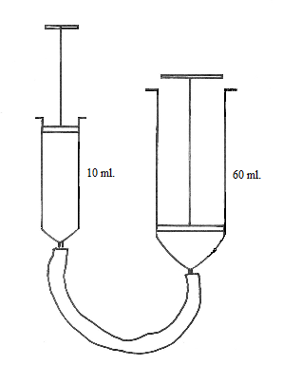
Relationship of Force, Pressure & Area - 2
Use the 60ml. and 10ml. piston and a short piece of tubing
Connect the tubing to the 60ml. piston and fill it to 15 ml. full of water
Turn the 60 ml. piston upside-down and gently press the plunger to remove the air bubbles
Push the plunger of the 10ml. piston in and then connect to the tubing
Pull the plunger of the 10ml. piston out and in and explore this “hydraulic lift”
Notes:
1: Feel the difference in the forces acting on the plungers of the two pistons and determine that a greater force acts on the plunger of the 60ml. piston compared to the force acting on the 10ml. plunger

Slide 9
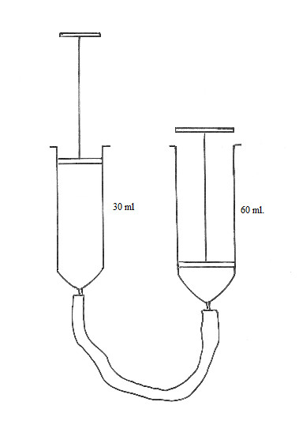
Relationship of Force, Pressure & Area - 3
Force equals pressure times the
area, (F = P X A). Since the area
of the big piston is larger, the force
is multiplied while the pressure of the
water is the same between the two
pistons.
In the same way as before connect this system.
What do you expect will happen when the plunger of the 30ml. piston is moved out and in?
Notes:
1: Compare the movement of the plungers and the forces involved.

Slide 10
Solving a problem involving Force, Pressure & Area
In the last system – a 30 ml. piston connected to a 60ml. piston – the pressure of the fluid in the pistons is the same (Pascal’s Law)
However, the diameter of the 30ml. piston is 1” and of the 60ml. is 1¼”
Estimate the mechanical advantage of using the larger piston by feeling the forces involved
Calculate the difference between the forces acting in and on the plunger of each piston?
Notes:
Call the equal pressure P(e). The area of a syringe is given by the formula: πr², where r is the radius = diameter/2
Area of the 30ml. syringe = π (½)² and of the 60ml. syringe = π (⅝)², the units are in². (⅝ = 1¼/2). As F=P(e) x Area, and P(e) is constant between the syringes, the ratio of the forces is therefore ¼ : 25/64 or 16/64 : 25/64 or 16:25.
Thus the force exerted by the 60ml. syringe on its plunger is approximately 1½ times that exerted by the 30ml. syringe on its plunger – in other words the larger syringe provides a significantly greater mechanical advantage

Slide 11
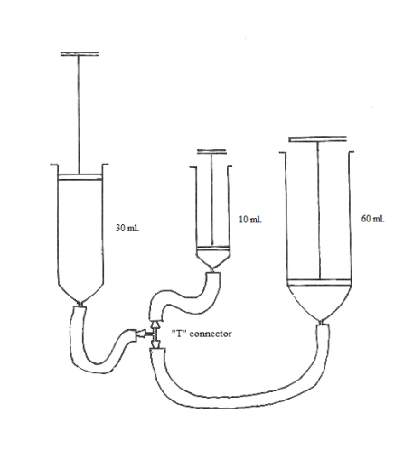
Exploring a fluidic system
Using all pistons, tubing and the “T” connector form this system
What will happen when the plunger of the 30ml. piston is pushed in?
Explore the system and explain the movement of the plungers using what you know about force, pressure and area.
Why does the smallest piston not move in and out as far as you might expect?
Notes:
The diameter of the syringes are: 10ml.= 11/16; 30ml. = 1”; 60ml. = 1¼”
The ratio of the areas, and therefore the force acting on the plungers is 121:256:400

Slide 12
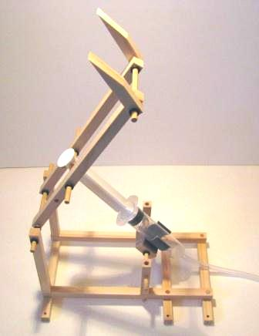
Building Activity – Up & Over model
Machines that use fluid power actuate devices using levers (and other mechanical arrangements) to provide the desired result
In the model shown, the actuating piston drives a class 3 lever where the “effort” (the piston) is applied between the fulcrum and the “load” or “resistance” (the forks)
The position of actuating piston could be moved closer to the fulcrum to produce a different result

Slide 13
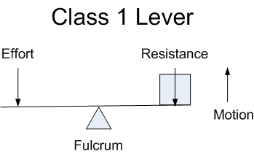
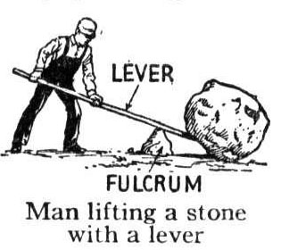
Classes of Levers - 1
Class 1 Lever
Fulcrum in the middle: the effort is applied on one side of the fulcrum and the resistance on the other side – e.g. a crowbar or a pair of scissors or a seesaw

Slide 14
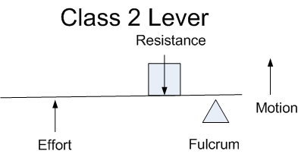
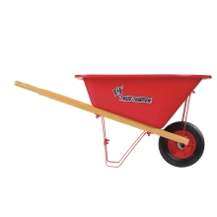
Classes of Levers - 2
Class 2 Lever
Resistance in the middle: the effort is applied on one side of the resistance and the fulcrum is located on the other side – e.g. a wheelbarrow or the rotating base of the robotic arm

Slide 15
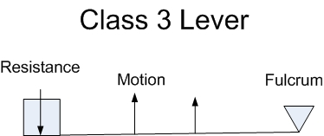
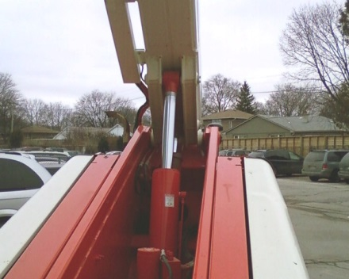
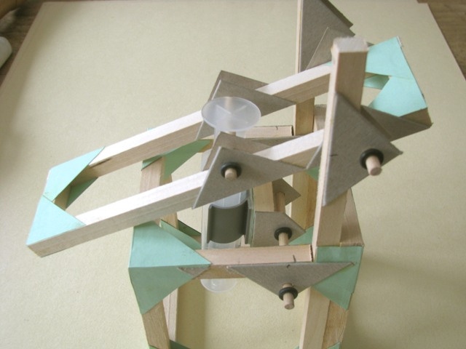
Classes of Levers - 3
Class 3 Levers
Effort in the middle: the resistance is on one side of the effort and the fulcrum is located on the other side, for example, a pair of tweezers or the platform lifter

Slide 16
Analysing a Fluid Power System
How do you expect the action of the system change if the position of the effort is moved from “A” to “B” ?
Calculate the change in mechanical advantage when the position of the effort is moved from “A” to “B”
A
B

