Slide 1
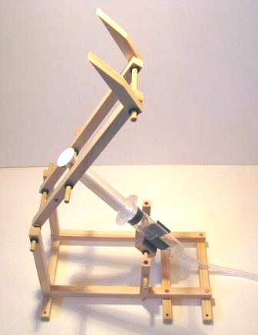
Up and Over
Step-by-step assembly instructions

Slide 2
Contents of Up and Over Kit
Wooden pieces (⅜” cross-section):
4 X 20 cm (7.87”); 2 X 11cm (4.33”); 3 X 12cm (4.72”); 2 X 6cm (2.36”);
2 X forks
1 X 3²cm Block (1.81²”)
Syringes, 20cc: 2 (1 has a hole in the plunger)
Plastic Tubing: 1 length
Wooden dowel, 3/16” diam.: 2 X 10.5cm (4.13”); 1 X 8cm (3.15”); 1 X 6.5cm (2.56”); 2 X 4cm (1.57”); 2 X 3.5cm (1.38”); 2 X 2cm (0.79”)
Syringe Holder: 1
Mini-washers: 10
Plus a small piece of sandpaper

Slide 4
Lay 3 X 12cm (4.72”) arms (with 3 holes) on the working surface. Connect 2 X 20cm (7.87”) pieces (with 4 holes) to them using the smallest lengths of dowel. Use 2 X 4cm (1.57”) dowel in the holes shown at the top of the picture below. Use 2 X 3.5cm ( 1.38”) in the “top-middle” holes to connect the 6cm (2.36”) pieces and 2 X 2cm (0.79”) in the bottom holes – to flush. The holes in the side of the 6cm pieces face across the width.

Slide 5
Use the 8cm (3.15”) dowel to connect the two forks to the other two 20cm (7.87”) pieces. Use the holes at the “top end” (as before). The forks are placed at 45° to the long pieces and can be secured using a tiny amount of wood glue on the dowel.

Slide 6
Insert a 10.5cm (4.13”) dowel through the 3cm block and secure with two mini-washers, as shown. A piece of cardboard could be glued to the underside of the block for extra strength if desired. Strip off the plastic from the syringe holder and press firmly onto the 3cm block.

Slide 7
Slide to dowel holding the 3cm block and the syringe holder through the side holes of the 6cm (2.36”) upright, as shown below. Use two mini-washers to secure the dowel on the outside of the 6cm piece.

Slide 8
Push the 6.5cm (2.56”) dowel through the hole in the plunger of one of the syringes and then through the “top-middle” holes of the long pieces with the fork attached, as shown below). Use two mini-washers to secure.

Slide 9
Connect the 11cm (4.33”) pieces or holders to the protruding 4.5cm dowel. Use the other 10.5cm dowel to attached the fork arm to the “top” holes of the 11cm pieces and four mini-washers, as shown below

Slide 10
Swing the arm over and push the syringe into its holder. The device will look like the picture below -

Slide 11
Push the plunger all the way into the syringe and position the syringe in the holder as shown below. Connect the tubing to the syringe. Extend the plunger of the other syringe and connect it to the other end of the tubing. Air and water can be used in the syringes to compare pneumatic and hydraulic operation. Use a very small drop of washing-up liquid with the water as a lubricant. The position of the 6.5cm dowel can also be changed to create a different levered motion.

