Slide 1
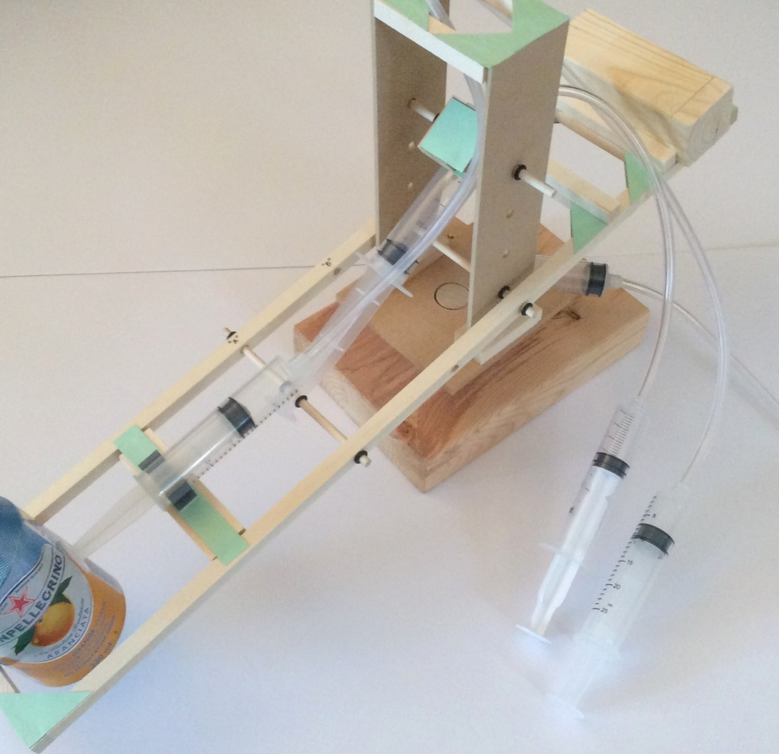
STEM Hydraulic Arm
Assembly Instructions

Slide 2
Building the Prototype
Identify the contents of the kit from slide 3
Layout the contents and sort by shape and size. In particular measure the wooden pieces as you will need to be precise when using them
1 pair – Follow instructions: Part 1 – Building the structure
1 pair – Follow instructions: Part 2 – Building the Arm and platforms

Slide 3
Contents of STEM Arm Kit
Wooden pieces (⅜” cross-section):
2 X 19⅝”; 5 X 3⅞”; 4 X 3⅛”; 2 X 2⅞”; 4 X 1⅞”; 2 X 1¼”; 3 X 1⅛”
Green corner gussets: 1 card
Pistons, 20cc: 6 (2 have holes in the plunger); Piston Holders: 3 (all white)
Plastic Tubing: 1 length 4ft.
Wooden dowel, 3/16” diam.: 3 X 5”; 1 X 2”; 1 X 1”+
Wooden dowel, 7/8” diam.: 1 X 3¾”
Mini-washers: 12; Rubber bands: 1
Platform 4”² X 1 (drilled ⅞” and 3/16” holes)
Wooden base with two holes
Thin m.d.f. walls X 2 with 4 holes in each
Larger wheel with 7/8” hole; Smaller wheels X 2; White disk X 1
Objects: 1 round X 3¾”, 1 square X 3⅞”
Plus a piece of sandpaper; Stirring Sticks: 1

Slide 4
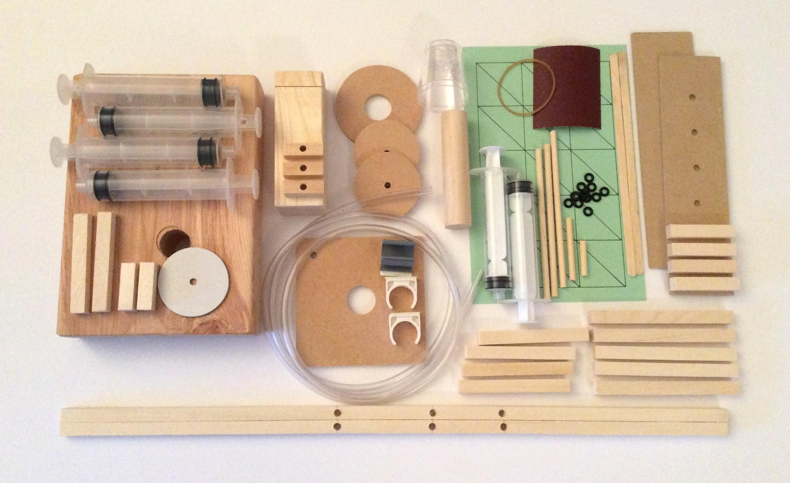
Kit Contents

Slide 5
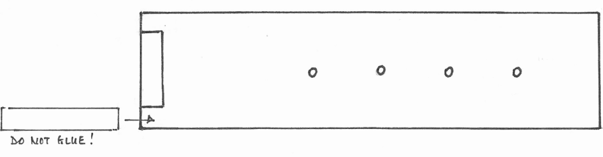
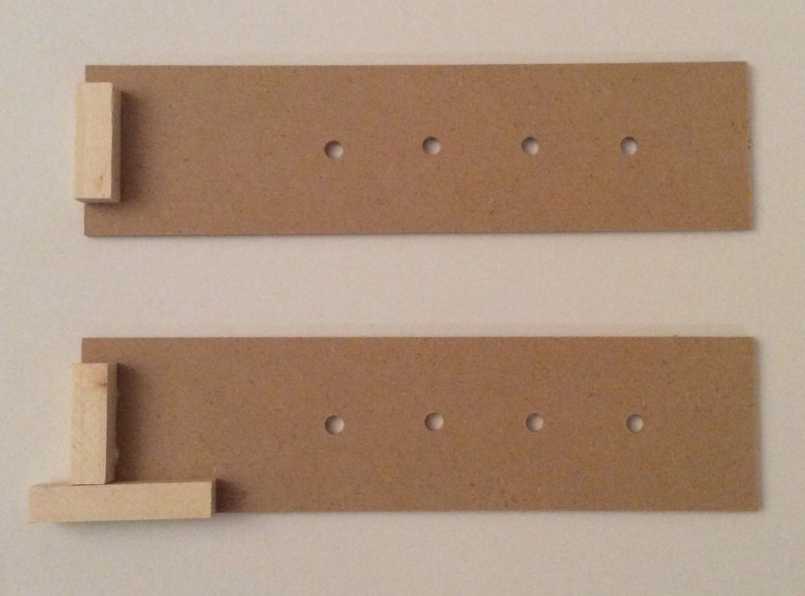
Part 1: Building the structure
Glue a 1¼” piece to each m.d.f. rectangle.
Make sure that another wooden piece would fit on each end

Slide 6
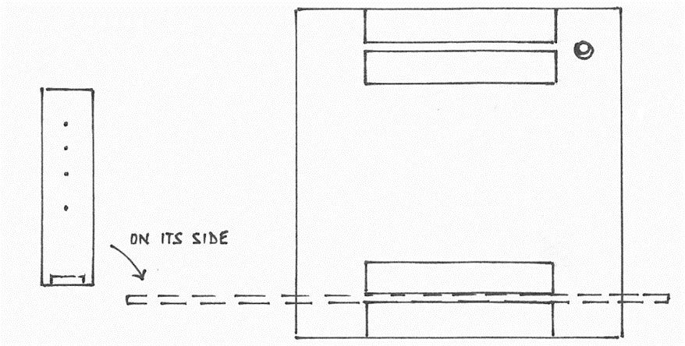
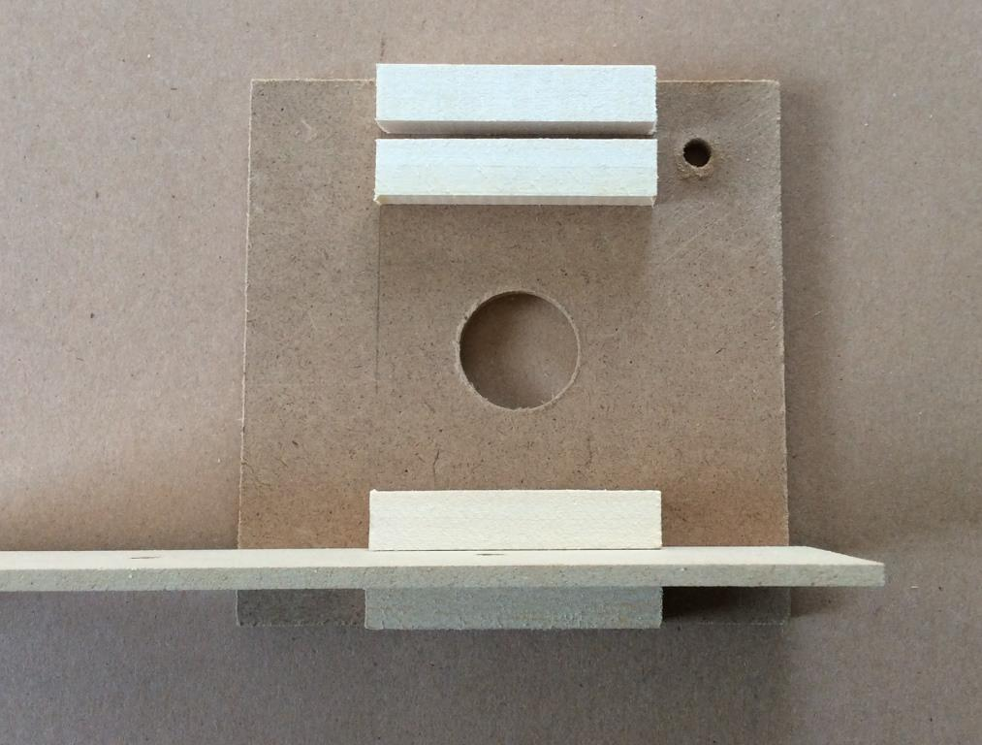
Glue four 1⅞” long pieces onto the 4” square, as shown, so that they are 1” from the sides.
The 1⅞”pieces should be placed 1/16” from the edges of the top and bottom sides of the 4” square.
There should be a gap between the pieces so that the m.d.f. rectangles will fit

Slide 7
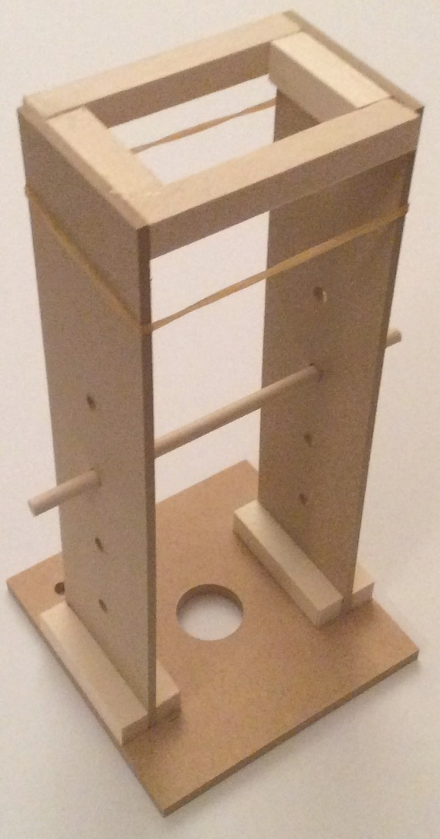
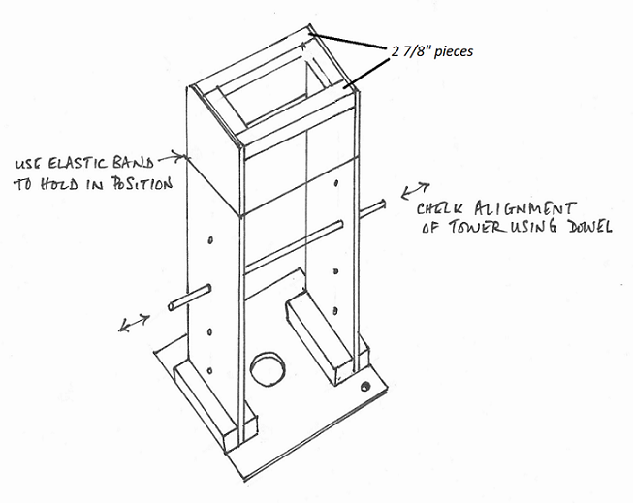
Glue the m.d.f. rectangles with four holes into position on the 4” square platform. Carefully place a small amount of glue in the ⅛” gap between the 1⅞” pieces on the platform. To make sure the sides of the tower are vertical use the two 2⅞” pieces and the elastic band as shown below. A small amount of glue will be applied to the ends of the 2⅞” pieces. The Tower will be slightly larger at the top

Slide 8
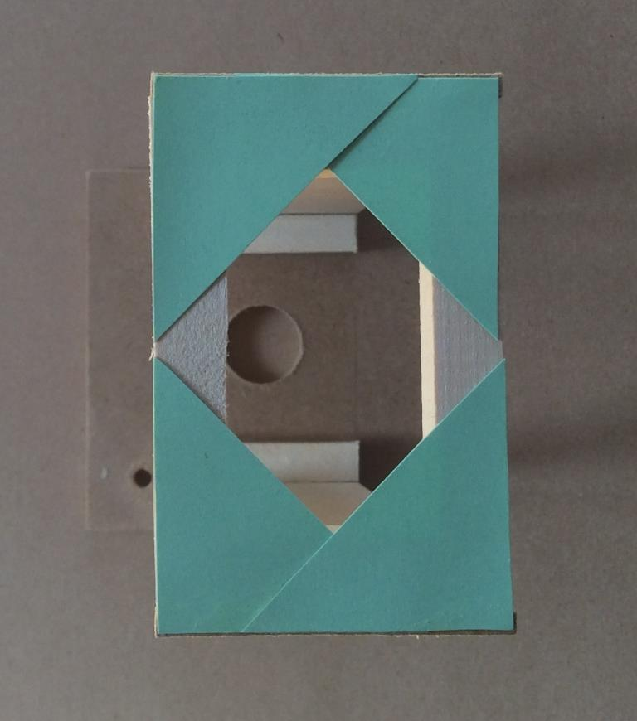
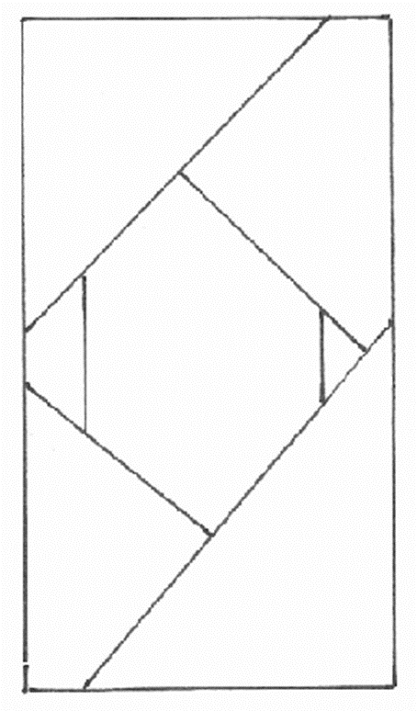
Glue 4 green triangles onto the top of the tower to secure the frame
Allow everything to dry

Slide 9
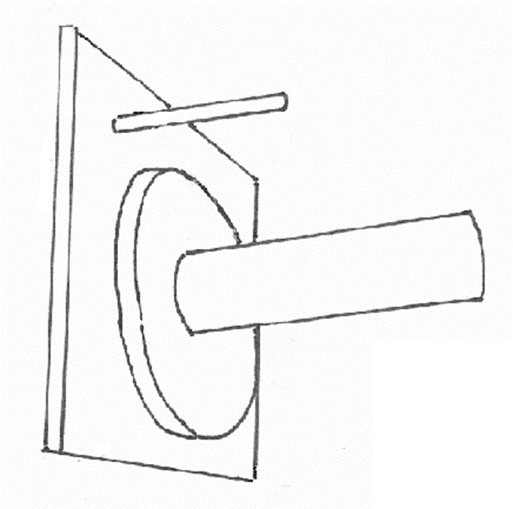
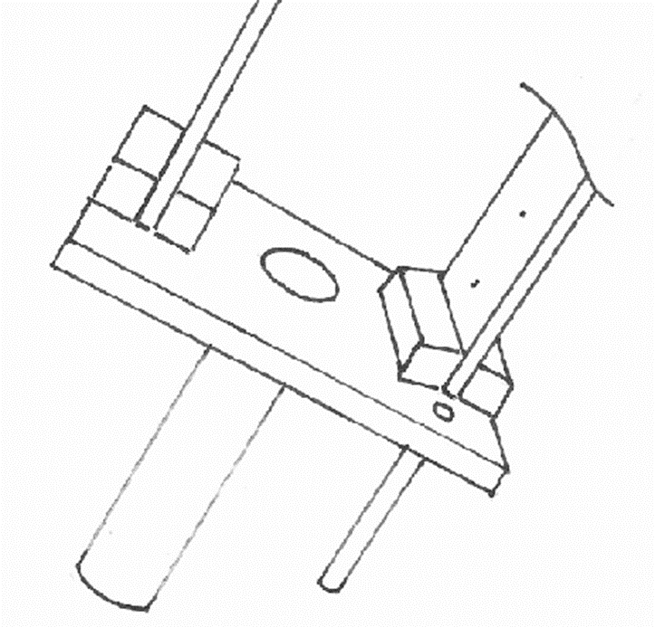
Glue the large wheel with the ⅞” hole under the 4” square and the ⅞” dowel through the hole of the wheel and the platform so it is flush with the top surface of the 4” square. Finally glue the 2” dowel into the hole in the corner of the platform so it is flush with the top of it. Place on one side to dry.
End of Part 1

Slide 10
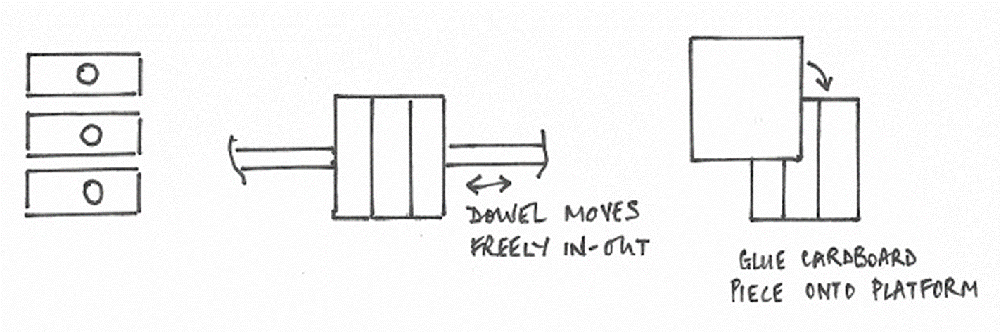
Part 2: Building the Arm and Platforms
Glue the three 1⅛” pieces with holes together using a small amount of glue between the pieces.
Make sure a piece of dowel fits through the aligned holes.
Cut out a piece of cardboard and glue it to the three piece platform

Slide 11
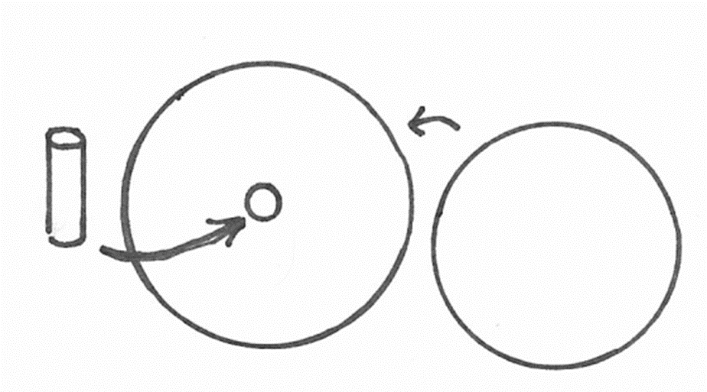
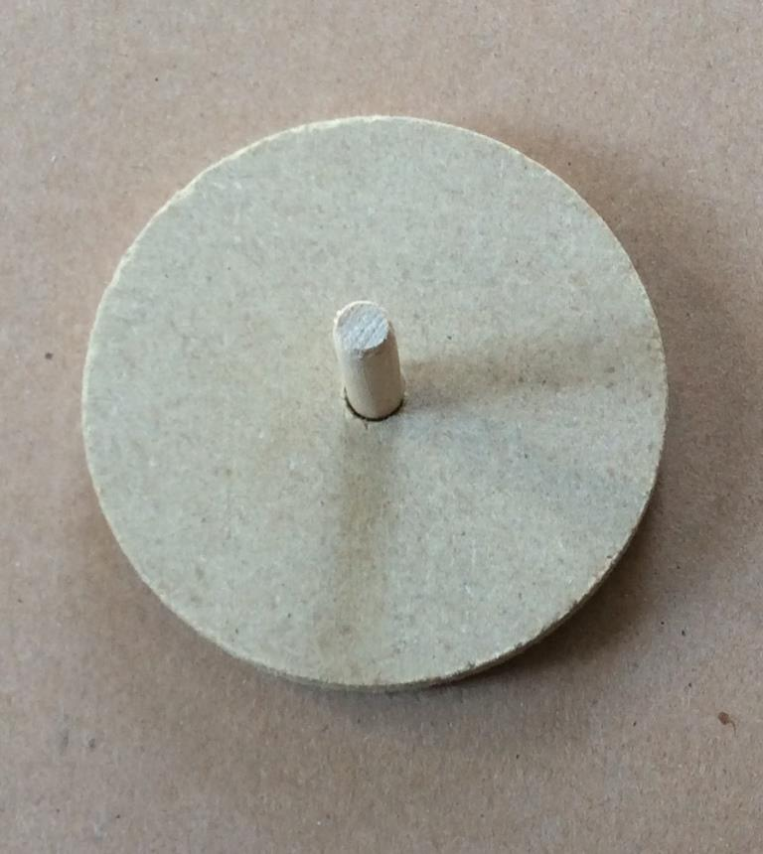
Glue the 1⅛” dowel rod into one of the smaller wheels.
Make sure the dowel rod is flushed with the underside side of the wheel that is in the picture below Glue the white cardboard disk to the wheel beneath the wheel and dowel rod

Slide 12
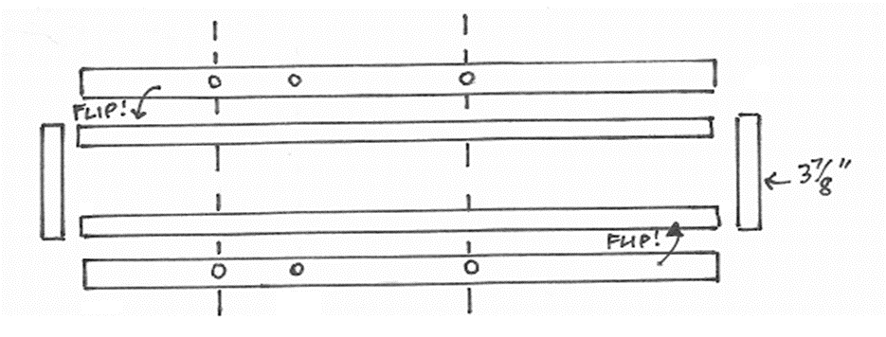
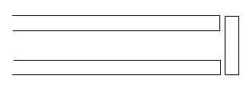
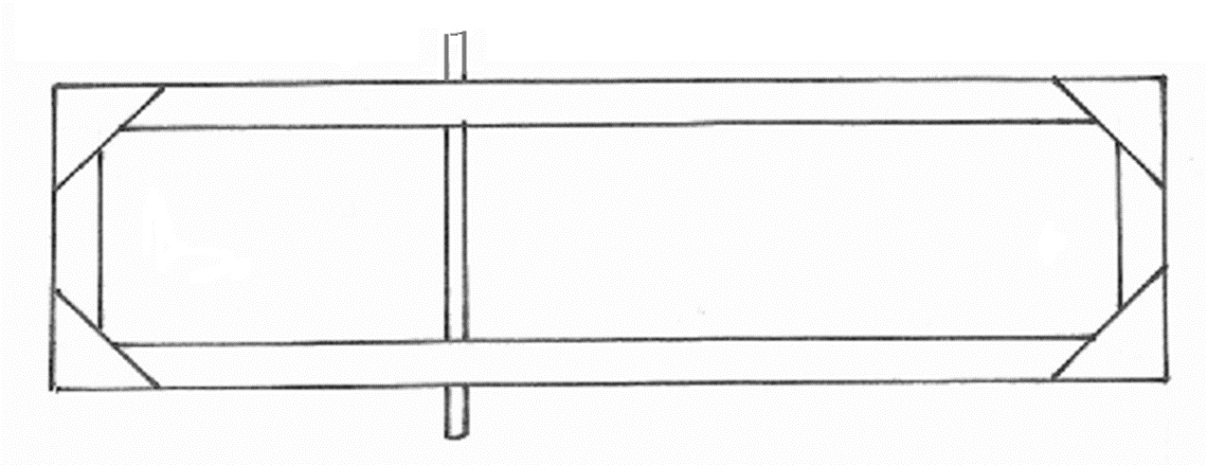
Join the 19⅝” pieces together using two 3⅞” pieces at each end. Glue green corners (gusset corners) to the pieces as shown. Check the position of the holes by making sure a dowel is at right-angles (90°) to the longer sides. A small amount of glue is best applied by the wooden stirrer. Glue one side first only

Slide 13
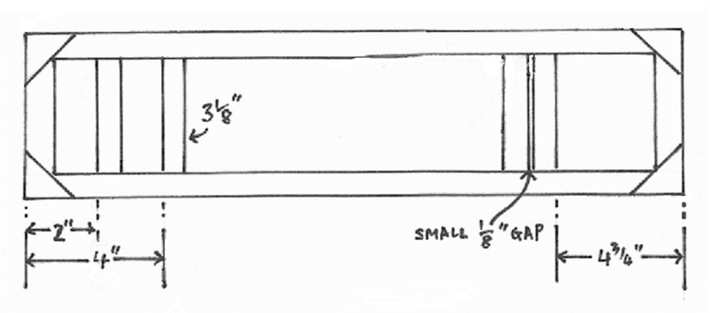
Lay the rectangle so that the two holes closest together on each are on the left side in the picture below. Glue the four 3⅛” pieces into the frame of the arm using gusset corners and a strip (from the edge of the green card). The edges closest to the left-hand end in the picture below are 2” and 4” from that end. The edge closest to the right-hand end below is 4¾” from that end. There is a ⅛” gap between the two pieces. See next slide

Slide 14
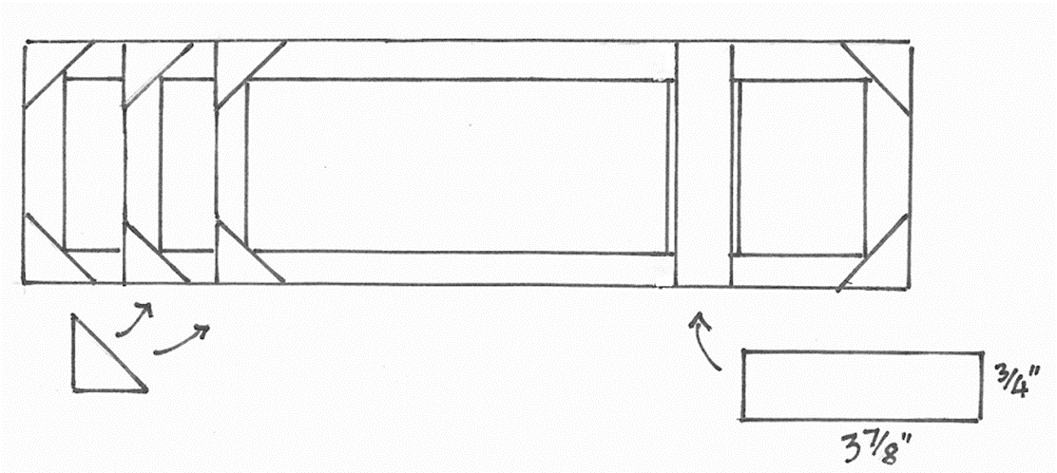
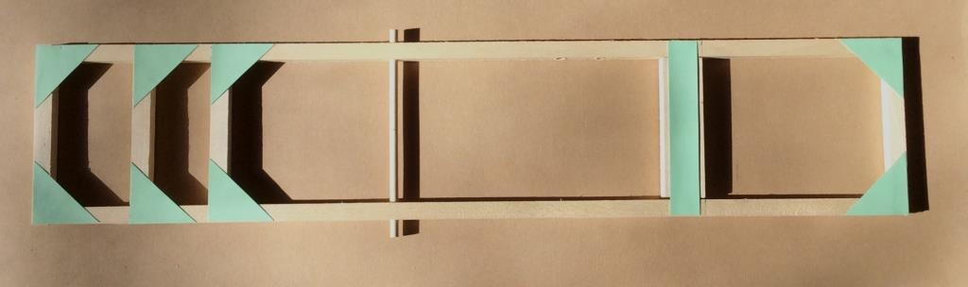
Glue the gussets and the rectangular strip on both sides.
Place on one side to dry

Slide 15
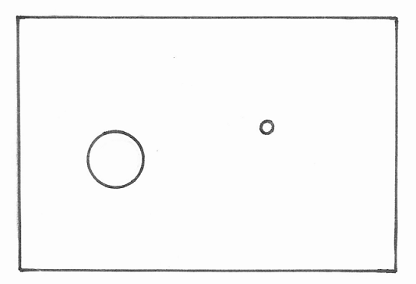
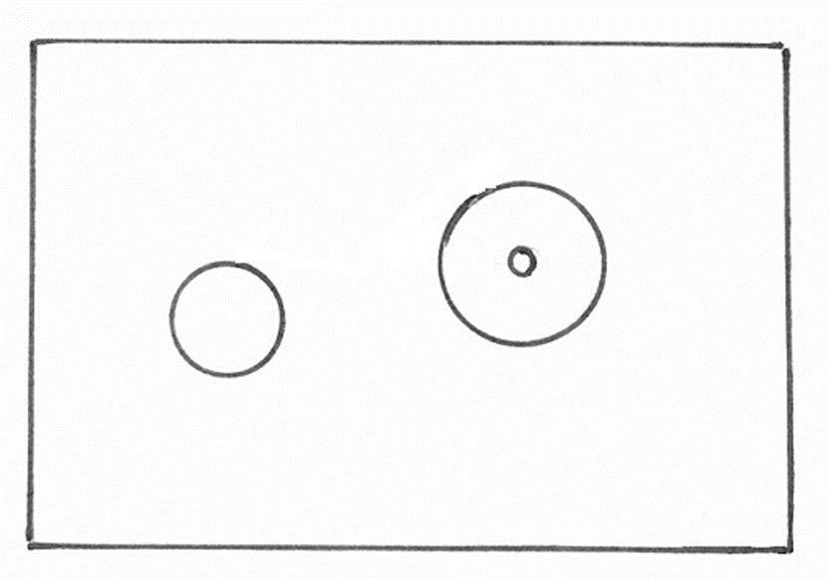
Arrange the block so that the two holes are on the top as shown below.
Glue the other small wheel to the hole in the wooden base so its smooth side is up. Make sure the holes align.

Slide 16
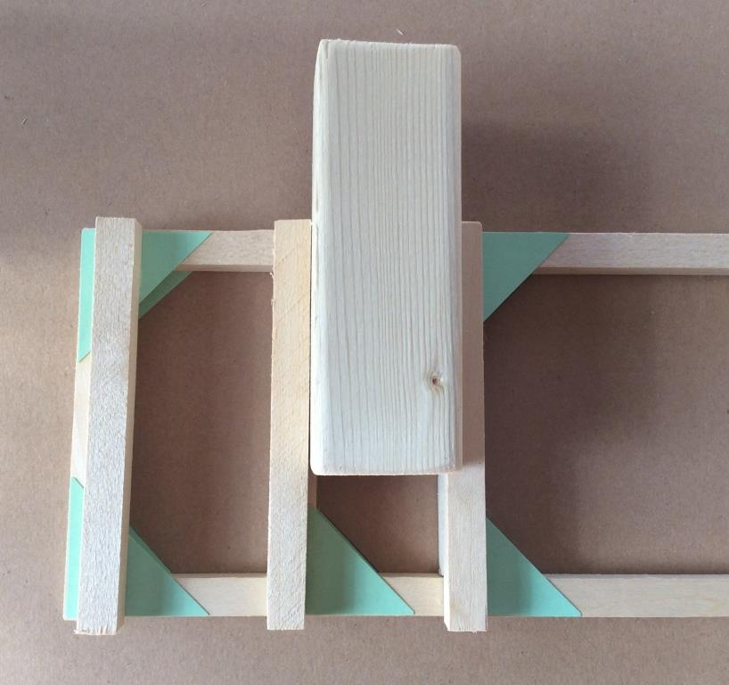
Glue three 3⅞” pieces in place to hold the cuboid wooden block
End of Part 2

Slide 17
Building the prototype - continued
Follow the remaining slides to complete the construction of the prototype device
Identify the 2 pistons that have holes in their plungers and put them on one side
Do not remove the white strip from the white or gray plastic piston holders until you are ready to fix them to the structure. When you do so press firmly into position – they do not work well a second time
Once you have finished the construction use the pistons to operate the device
What do you notice about the operation of this pneumatic device?
What would happen if the axles in the arm and tower platform were relocated?

Slide 18
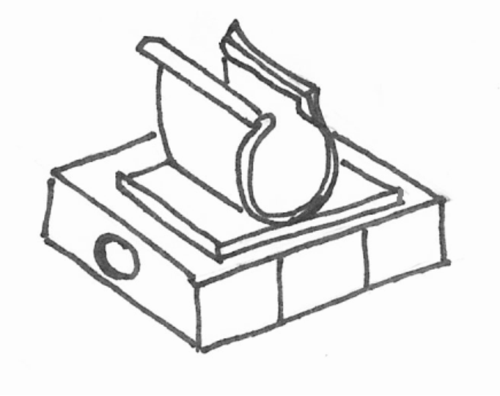
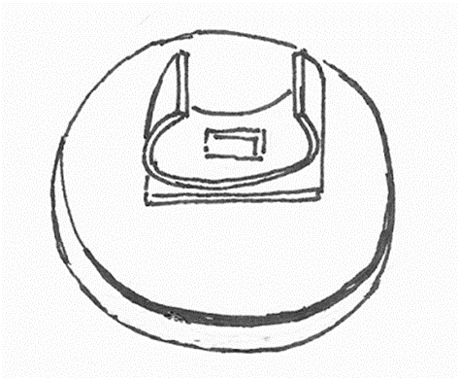
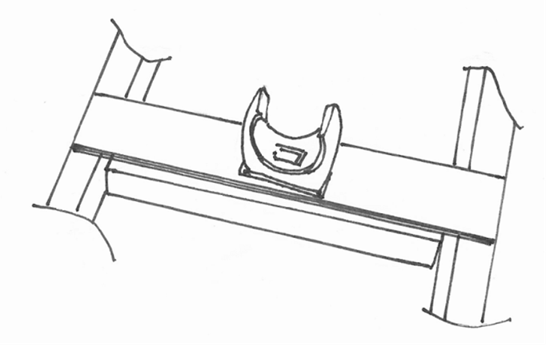
Connecting the pistons (actuators)
Piston clips are used to hold the pistons in place. To secure the clips remove the backing tape and press carefully and firmly into position.
Fix clips to the wheel and card and disk platform, the square platform and the arm platform. Make sure they are in the center of each

Slide 19
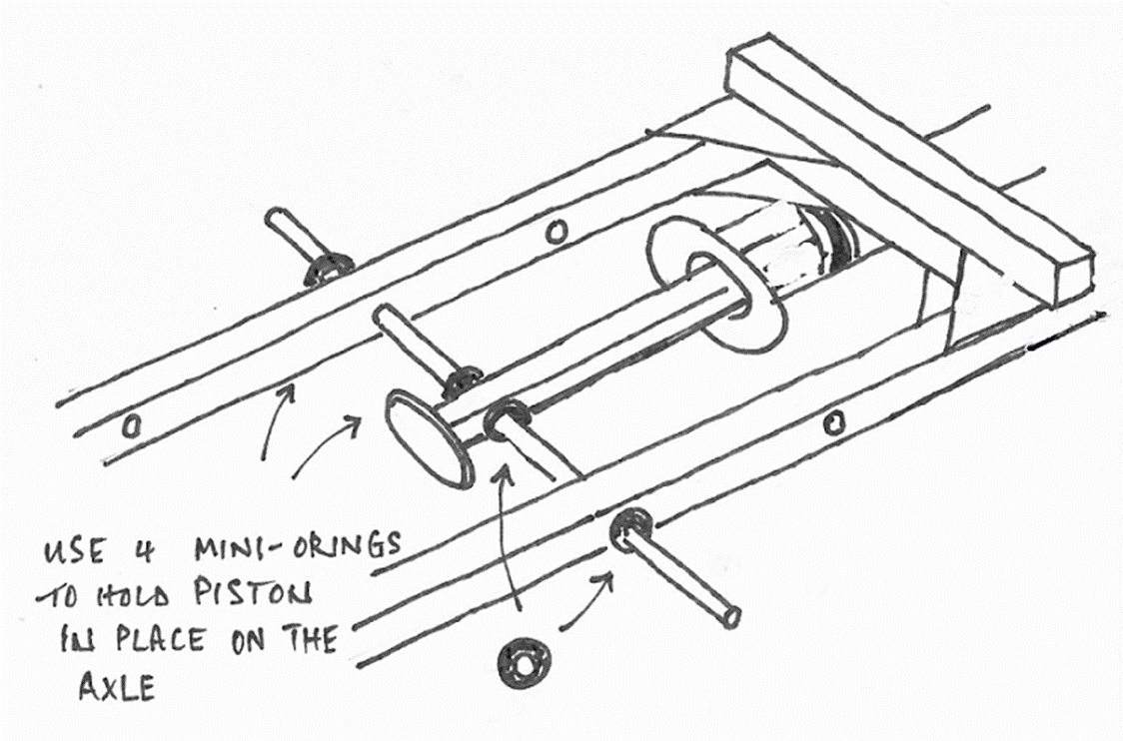
Mount a piston with a hole in its plunger into the middle holes of the arm.
Use 4 black mini-washers to secure the 5” dowel in place – two on the outside of the frame and two against the plunger.

Slide 20
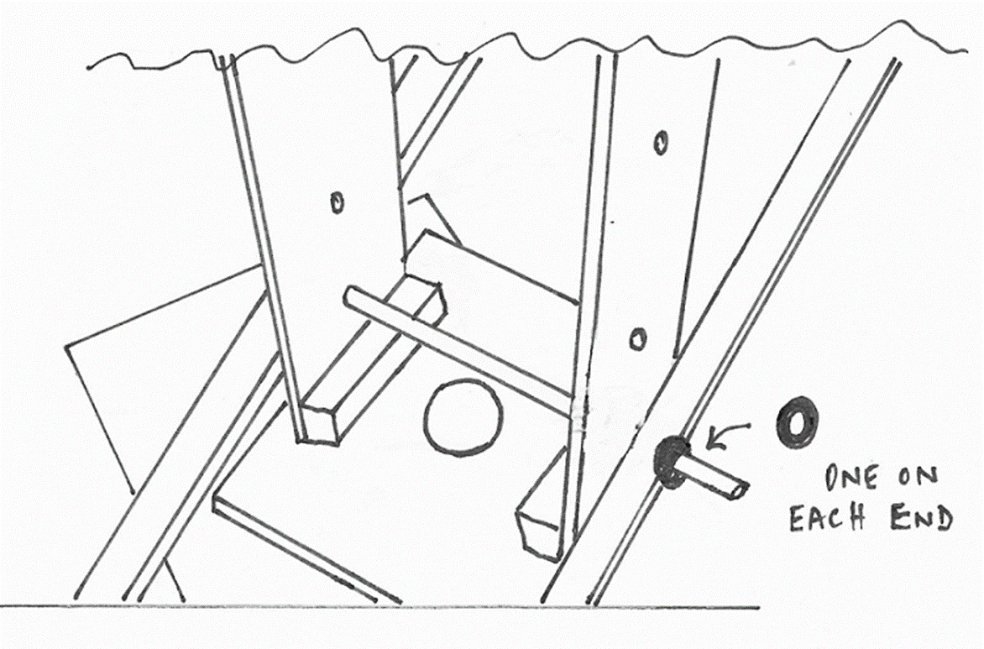
Insert the tower assembly into the wooden base and then mount the arm into the tower at the lowest position. Use 2 mini-washers to secure the 5” dowel, one on each side of the arm frame

Slide 21
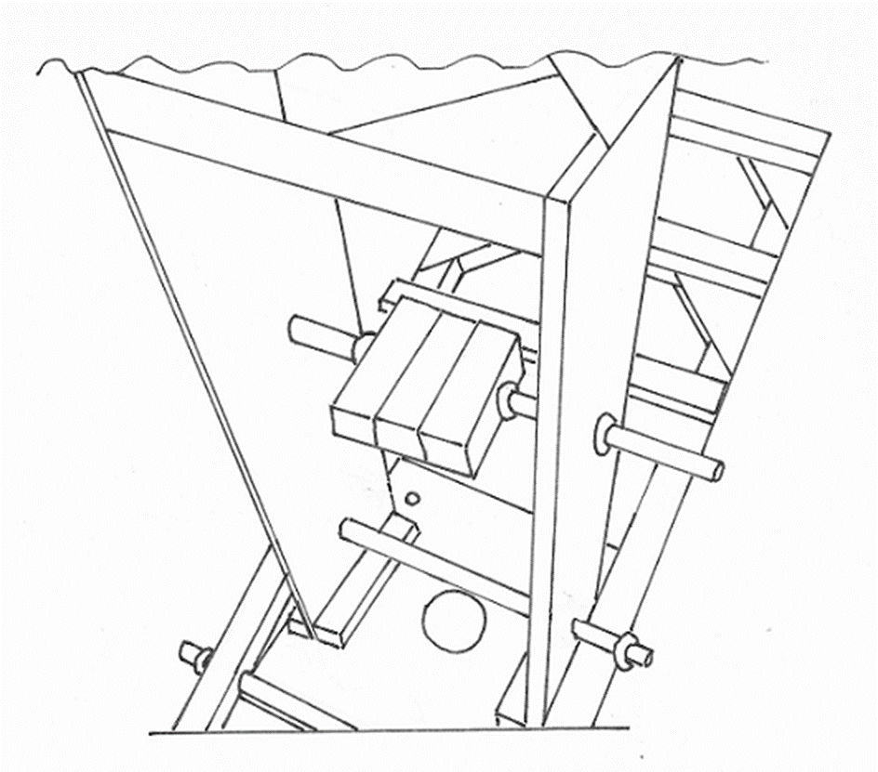
Mount the square platform with clip into the tower in the highest position. Use 4 mini-washers to secure the 5” dowel in place, two on the outside of the tower and two against the clip platform

Slide 22
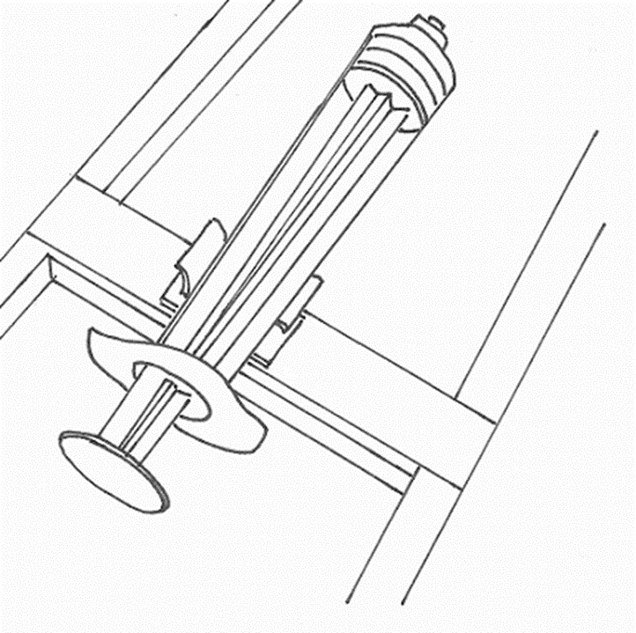
Insert the barrel of the piston attached to the arm into the clip on the square platform in the tower. The plunger will need to be extended. Then insert a piston without a hole in its plunger into the clip on the arm, as shown below

Slide 23
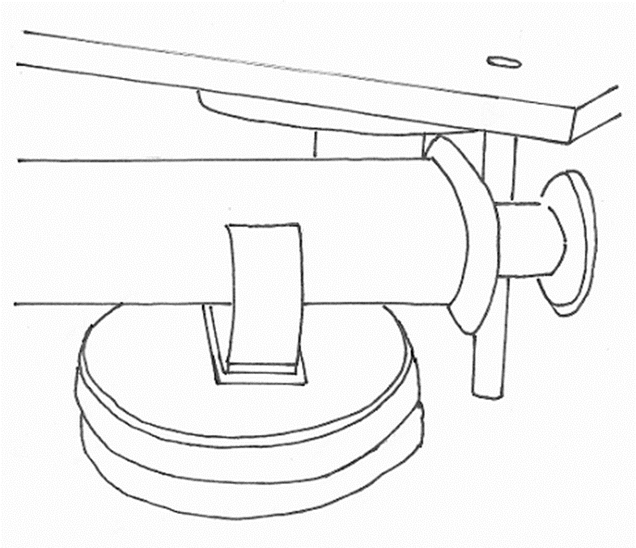
Place the dowel connected to the “white disk” platform into the wheel on the base.
Connect the remaining piston with a hole in its plunger to the 2” dowel connected to the 4” tower platform and place the piston into the clip

Slide 24
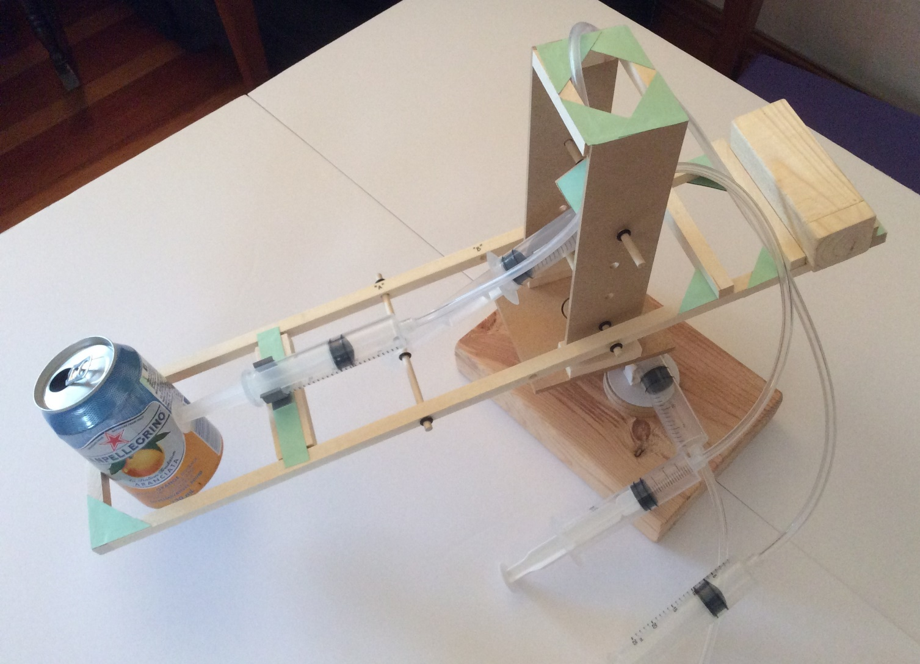
Test the device using pneumatics (air power)
The pistons on the arm and the base will be closed and the piston on the tower will be open (see below). Cut tubing into 10”, 14” and 24”lengths and connect to base, tower and arm respectively. Connect three pistons to the other end of the tubing so their start positions are complimentary (two open and one closed). The block is placed on the arm to act as a counter-balance.

Slide 25
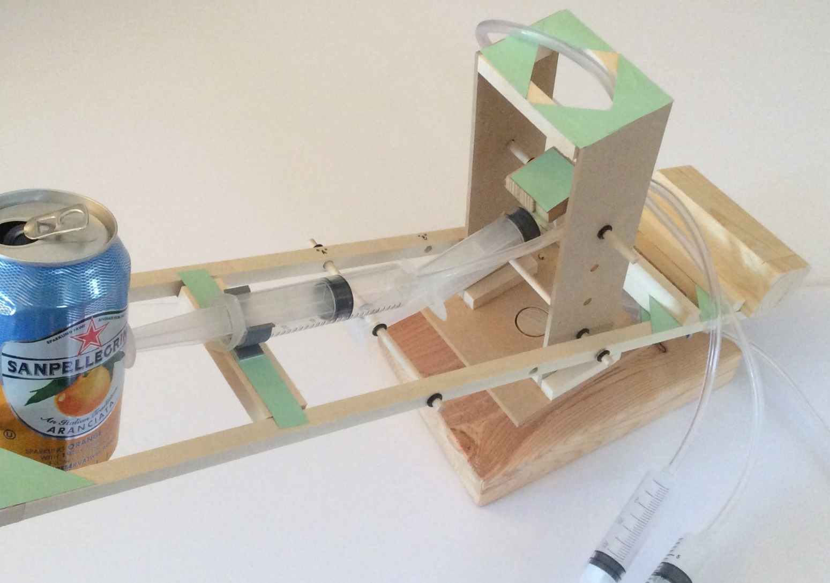
Your device will be capable of rotating and picking up and placing a soda can.

Slide 26
Investigating the STEM
As a group, identify as many applications of fluid power (pneumatics & hydraulics) as you can
If you have access to the Internet watch part of the video “A Force For Change" and identify applications of fluid power that interest you the most - http://www.nfpa.com/education/LearningResources-TVPrograms.aspx
Carefully remove two pistons from the prototype device and join them together with a length of tubing arranging the pistons so they are complimentary (one open, one closed)
Press the plungers back and forth to feel the force of pneumatic operation
Follow the next slide and install a 20cc piston in the tower and then determine the force required to initiate a downward movement of the plunger

Slide 27
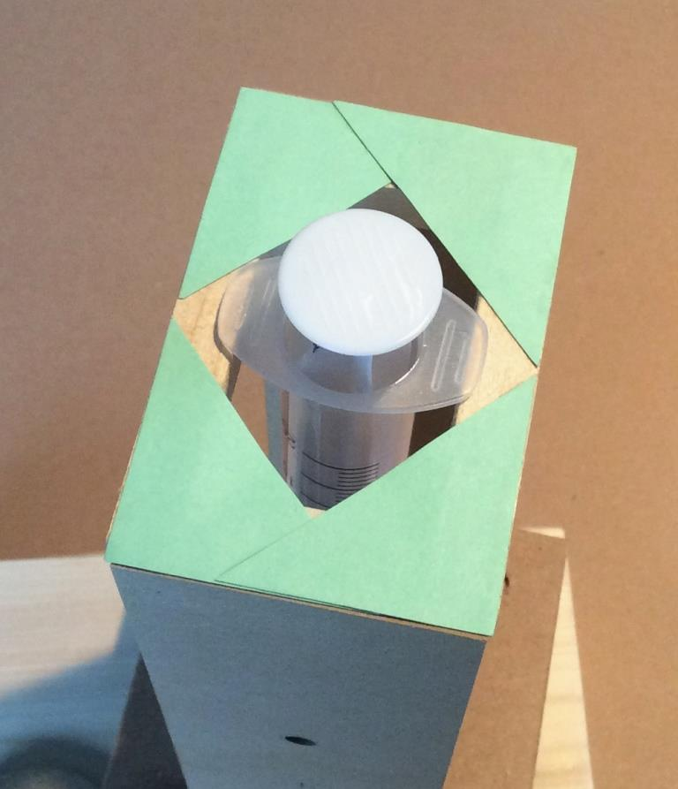
The picture below shows the 20cc piston in a closed position and installed in the tower of the device. It will be connected to the another 20cc piston (in the open position) by a length of 9” tubing. Open the piston in the tower by pushing the other piston closed and determine the force required to initiate a downward movement of the plunger. Use an empty soda can and carefully fill it with a small amount of water until the plunger begins to move. Weigh the can and the water and record your result

Slide 28
Investigating the STEM (continued)
Use two 20cc pistons and fill them with water as shown in the next slide. Ensure that the air in the pistons is removed from the system
Press the plungers back and forth to feel the force of hydraulic operation
Describe the difference between pneumatic and hydraulic operation
Write down as many factors and physical properties as you can think of that will influence the way pistons operate pneumatically and hydraulically
Share your ideas with your group making note of any that you haven’t thought of

Slide 29
Hydraulics - Filling pistons with water

Slide 30
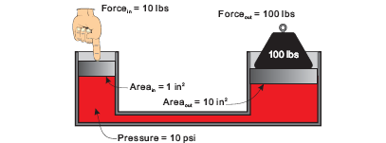
Hydraulic Lift
An application of Pascal’s Law – the force of 10lbs is applied to the narrow piston with a cross-sectional area of 1 in². Hence a pressure of 10 lbs/in² (psi) is constant in the closed system and is applied to the wider piston (10 in²). In consequence a mass of 100 lbs can be raised. However the distance moved by the 100lb mass will be significantly less compared to the distance moved by the input force (hand).
This is how a vehicle is raised in a service garage.

Slide 31
Investigating the STEM (continued)
Consider how the hydraulic lift (slide #30) gives a “mechanical advantage” to its user
Carefully disconnect one of the 20cc pistons and replace it with the large 60cc piston in the kit
Disconnect the other 20cc piston, empty its contents and then fill the 60cc piston and tubing with approx. 30cc water
Turn the 60cc piston upside-down and expel the air , setting the volume of water in it to 20cc
Carefully reconnect the 20cc piston taking care not to introduce air into the system
Install the 20cc piston in the tower and determine the force required to initiate a downward movement of its plunger, making note of the result in oz.
Repeat a second time and measure the distance the plunger of the 20cc piston moves and the distance the plunger of the 60cc piston moves, making note of the results in inches. (Mark the plungers before movement next to the barrels of the pistons)

Slide 32
Investigating the STEM (continued)
Install the 60cc piston in the tower and determine the force required to initiate a downward movement of its plunger, making note of the result in oz.
Note that it takes considerably less force to initiate movement when applied to the open 20cc piston compared to the 60cc piston (hydraulic lift principle)
Using the formula πr² for cross-sectional area, empty the contents of the system and remove the barrels from the 20cc and 60cc pistons, determine the cross-sectional area of each barrel
Determine the pressure inside the pistons when force is applied to both the 20cc and the 60cc piston, using the formula P (psi) = force (lb) / Area (in²)
For example if the force required to initiate downward movement of the 20cc plunger is 4ozғ and the cross-section area of the 20cc barrel is 0.45 in² then the pressure in the “20cc” system will be (4/16) lbғ / 0.45 in² = 0.56 psi
Record your calculations
Using your measurements of the distance travelled by the plungers use the formula: Work done (lb.ғ in.) = Force (lb.ғ) X distance travelled (in.) determine the work done by the two systems
Record your calculations

Slide 33

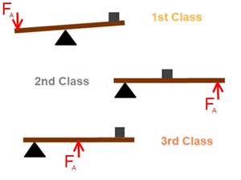
Levers
The mechanical arrangement below is similar to the hydraulic lift in that a small force is applied at one end of a lever to raise a larger mass at the other end. If the fulcrum (Δ) is 1ft from the center of the 100 lbs mass and the small force (hand) is applied 5ft. from the fulcrum then the small force can be calculated using (small force) X 5 = (100) X 1. The small force will be 20lbs. The lever is said to provide a mechanical advantage as less effort is required to move the load
There are 3 classes of lever. Which class of lever raised the arm in your device?

Slide 34
Finding the best set-up for your hydraulic arm
Watch the advertising video from Caterpillar “A Bull in a China Shop” and identify the parts of the machine that are hydraulically controlled: http://www.cat.com/en_US/articles/customer-stories/built-for-it/cat-mini-excavatorprovesitsnotabullinachinashop.html
Draw 2 tables with 5 columns (at least 2” wide) and 3 rows (at least 2” deep) as shown:
Fill the pistons and tubing with water (see slide #27), mount them on the structure and determine the best set-up for your hydraulic arm. There are many different possible arrangements for the arm (see slide# 33 for a couple of examples) however, some of them are not practical because of the dimensions of the pistons and the clips
Position “A”
Position “B”

Slide 35
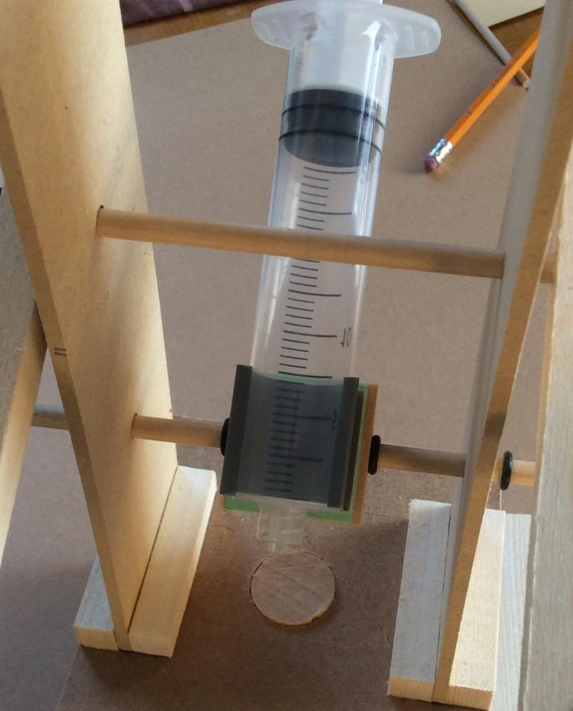
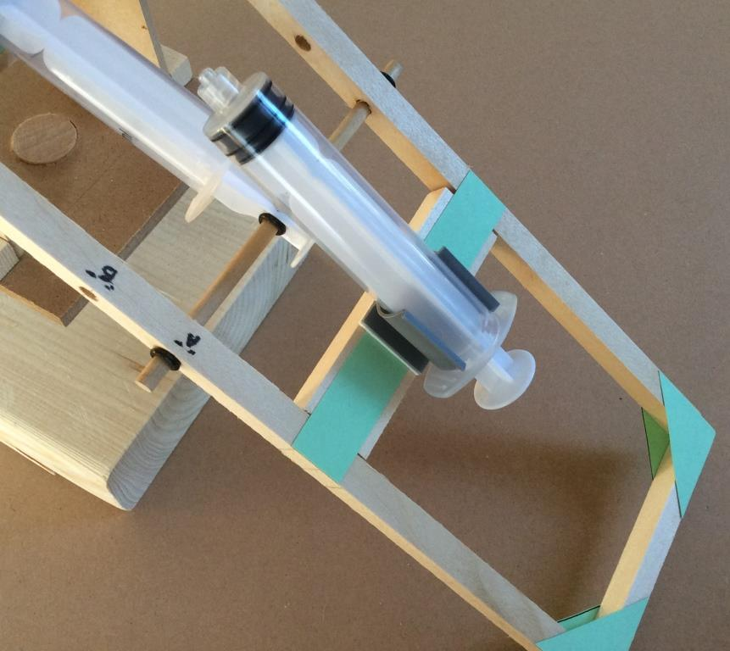
Alternate positions to explore.

Slide 36
Finding the best set-up for your hydraulic arm (continued)
Before you test your arrangement predict what will happen
  • is there anything that may go wrong with this design?
  • is there anything about this design that you’re unsure of?
  • what are the pros and cons of this design?
After you have tested your arrangement make notes in the table
  • did this design work the way you expected it to?
  • how long did it take you to move the soda cans?
  • what else could be done to improve that design?
Select your best arrangement , set it up and test it out

Slide 37
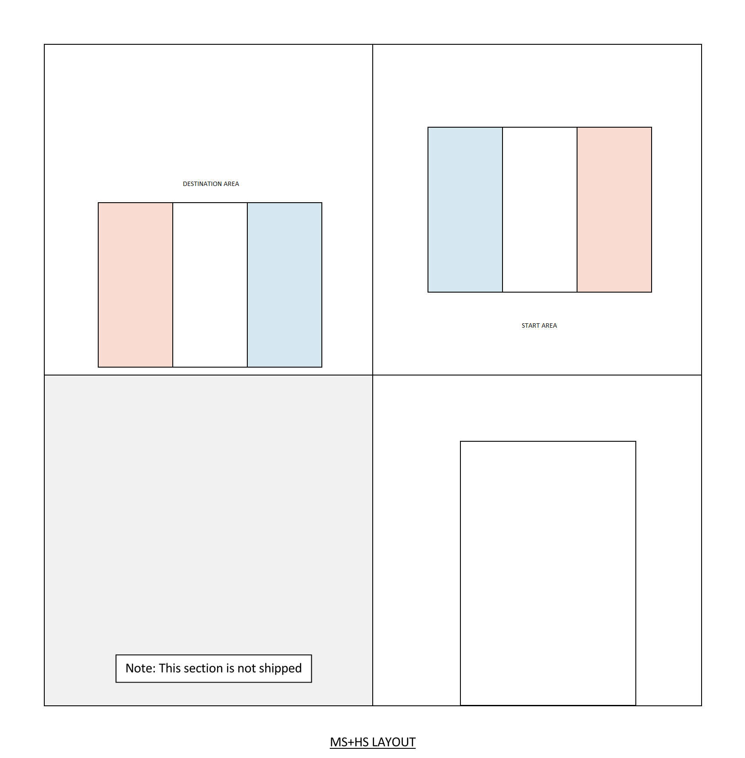
Designing a device to solve a more complicated task - 1

Slide 38
Designing a device to solve a more complicated task - 2
The last slide shows the layout for the task
The base of your arm will fit into the footprint area that is surrounded by the wooden wall.
The Challenge is to design different arms, by reusing the components of the arm and the extra “Challenge Parts”, so that your new arms can move an object form each colored area in the start area to the same colored area in the destination area
If you have a notebook handy
  Identify the constraints of each task (e.g. does the arm have to extend? How far does the arm have to rotate?)
  Do some research (e.g. YouTube “Fluid Power Challenge”) and the extra slides #39 - #45
  Make a sketch of your possible solutions
  Make a components list of what you think you will require while remembering you have a limited number of materials to use

Slide 39
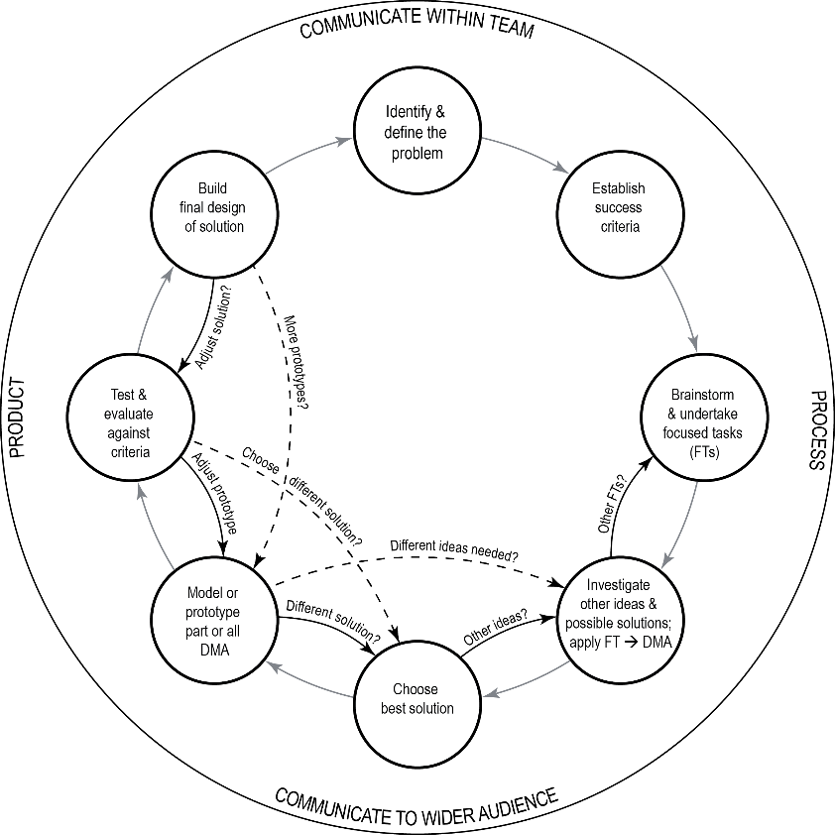
Designing a device to solve a more complicated task - 3
Follow a design process to produce a final design

Slide 40
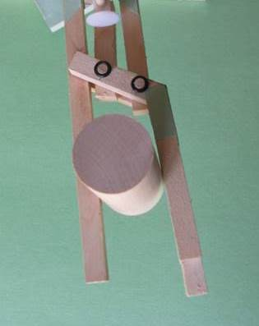
Alternative designs - 1

Slide 41
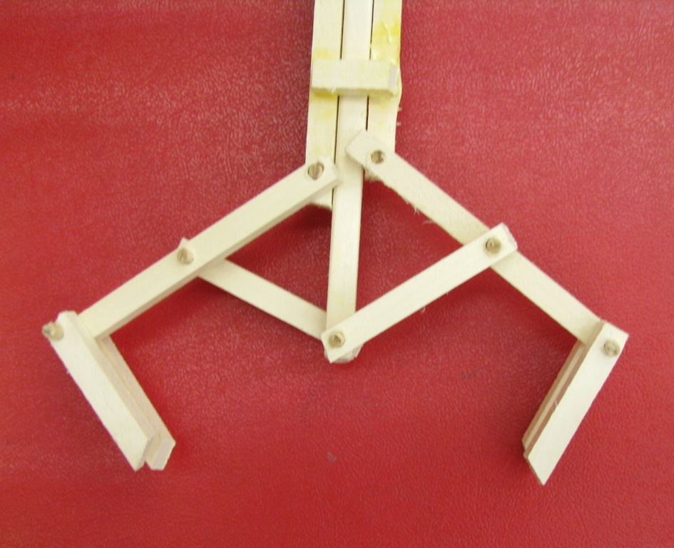
Alternative designs - 2

Slide 42
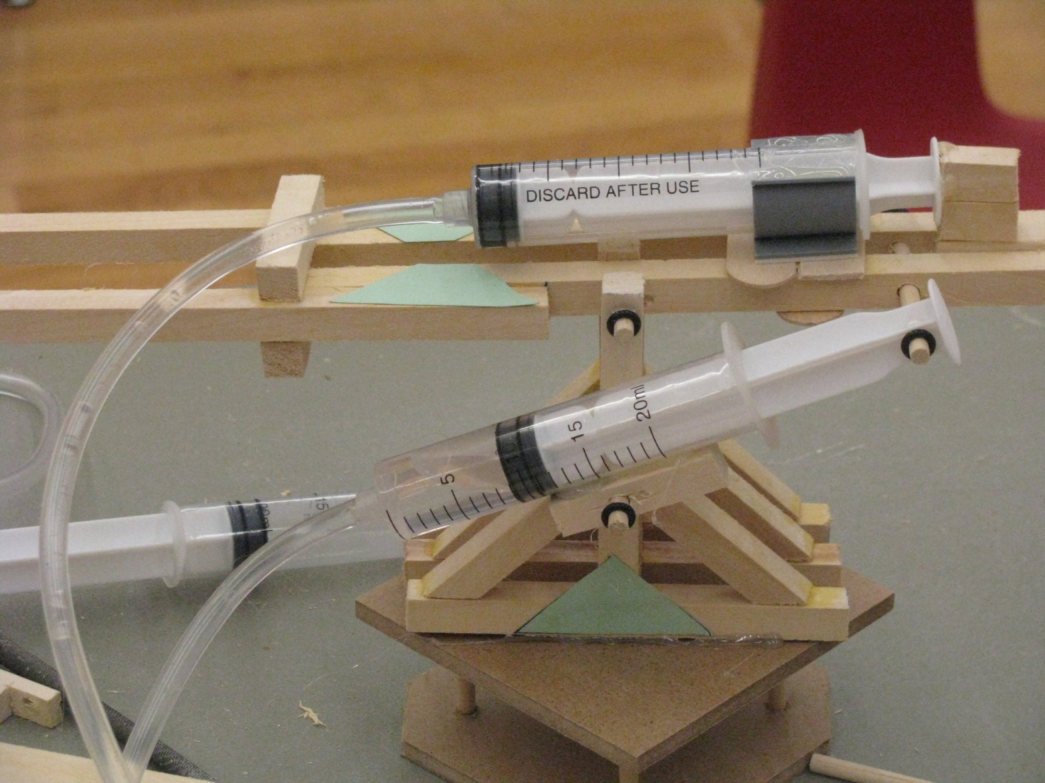
Alternative designs - 3

Slide 43
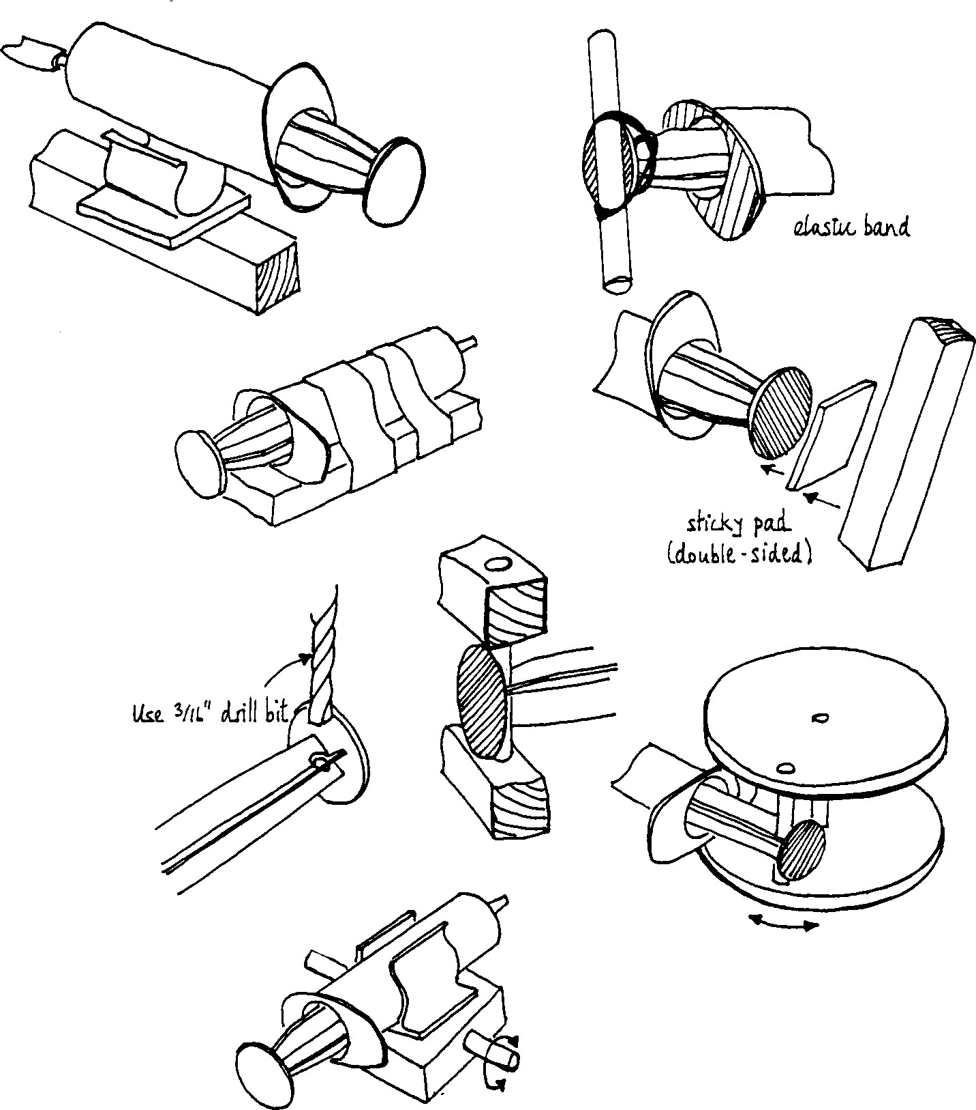

Slide 44
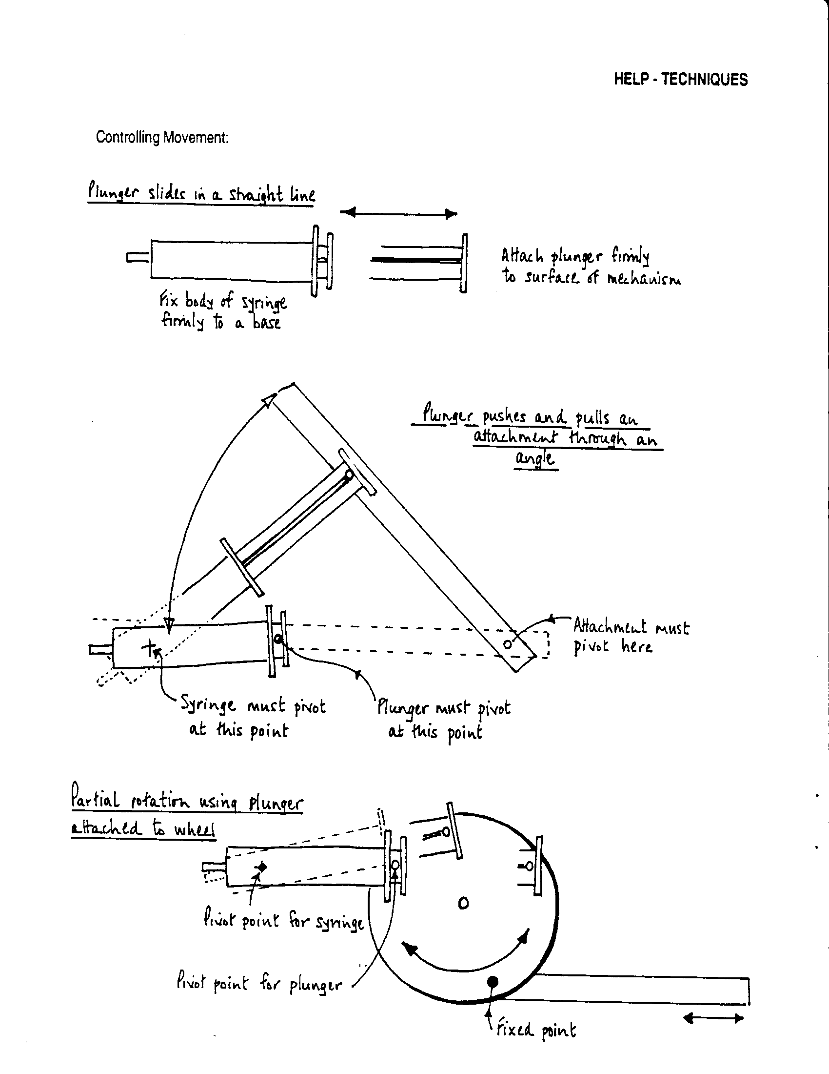

Slide 45
