Slide 1



ORIGINATOR: Mitch Bivens
EDITED BY: Stephen Rogers
Additional Contributions By:
2021 03

Slide 2
Please fill out the Pre-Survey to the best of your ability
Your name is not required!
Video link:
http://www.tpt.org/Fluid-Power:-A-Force-for-Change/

Slide 3
Safety
Safety is everyone’s responsibility!
Always wear safety glasses - even when not cutting or drilling
No Running, No Throwing, No Horse Play!
When sawing, drilling, filing or sanding;
  Ensure a mitre box securely clamped down
  Ensure each workpiece is secure & stable
  Ensure your hands/fingers are out of harms way
  Wipe sawdust, don’t blow
If you use the low-temp glue gun remember the tip is HOT & can burn
Questions?

Slide 4
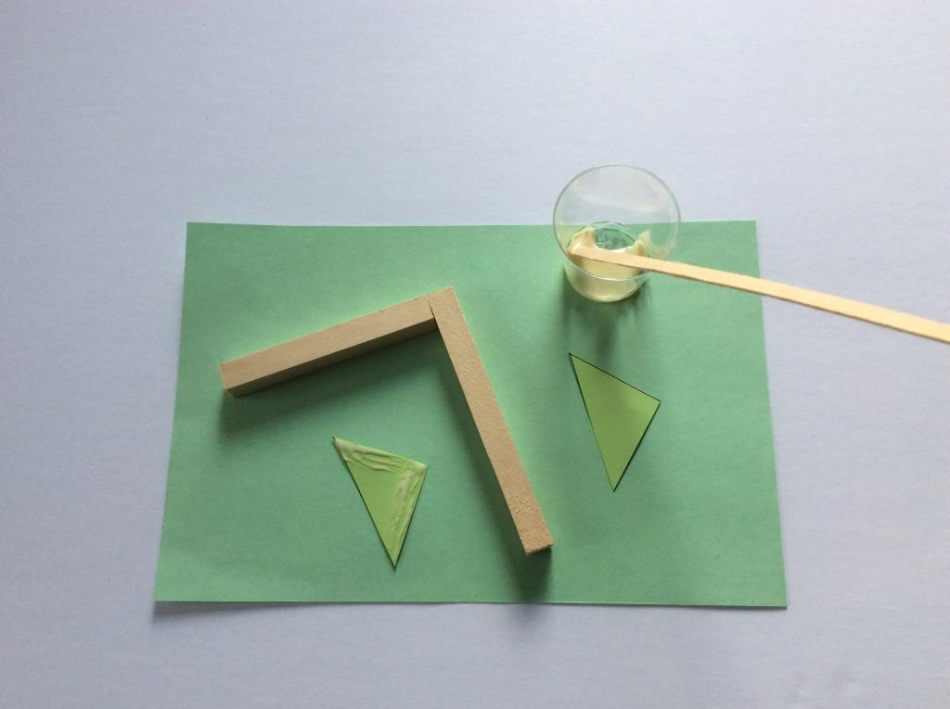
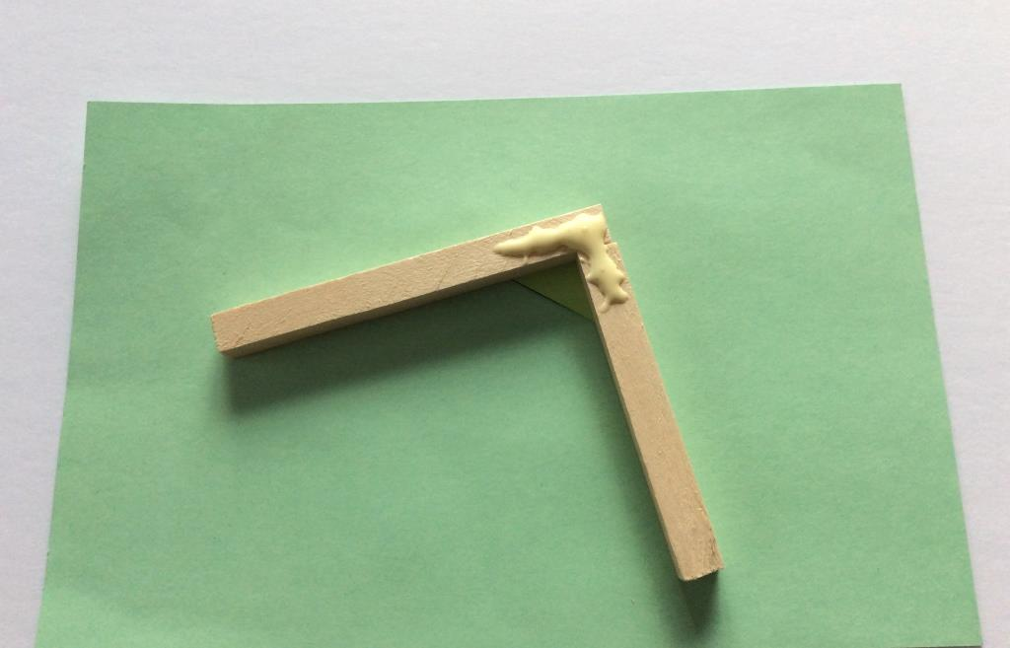
Using Wood Glue
Use a small amount of glue, the glue holder and stirring stick
√
X

Slide 5
Construction Tips
Have a plan
Measure twice, cut once
Accuracy is important
Wood Glue
  Less is more!
  Excessive glue takes longer to ‘set-up’ & does NOT result in a stronger joint
  Use stick to spread out glue on contact surfaces
  Use gussets and structural members for strength
  Consider Center of Gravity

Slide 6
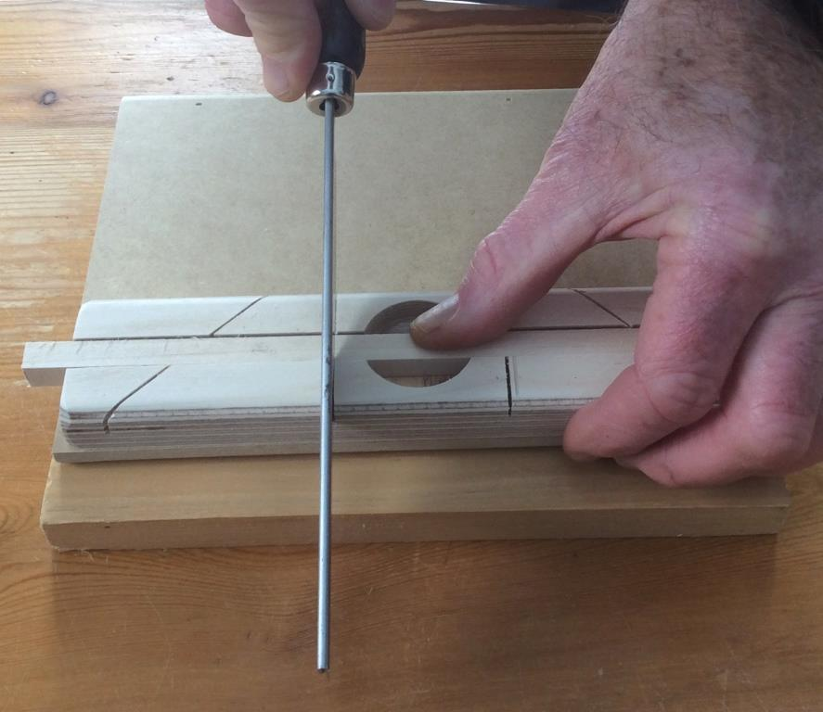
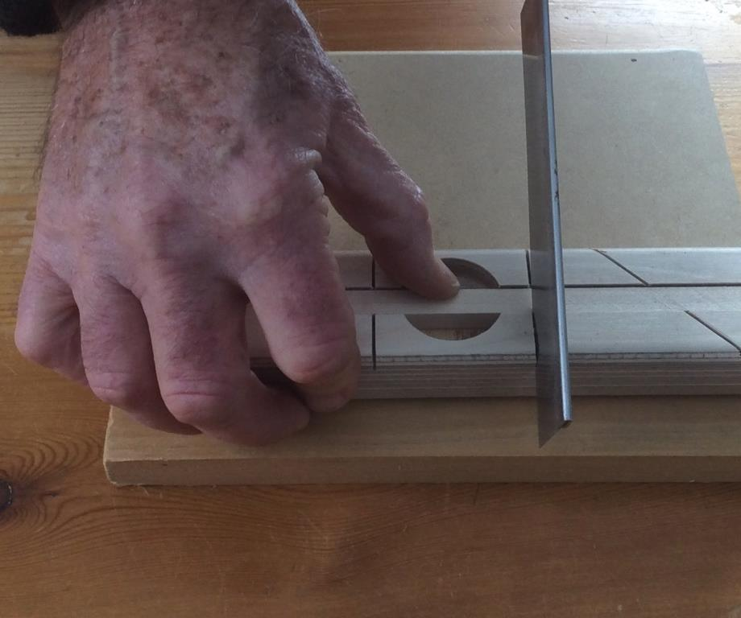
Using the miter box and hand saw to cut wood
RIGHTY
LEFTY

Slide 7
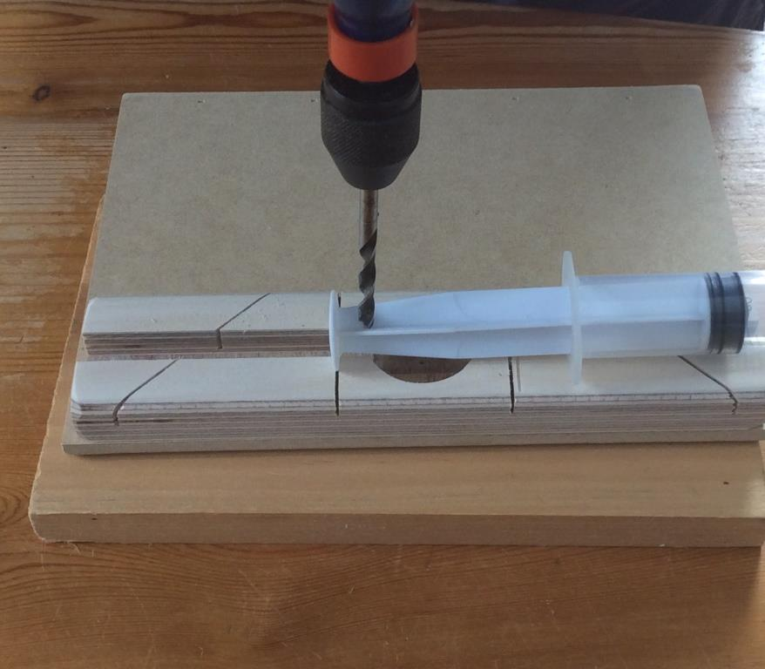
Using the hand drill to drill a hole in a syringe
Keep the drill upright – ask your partner to make sure and lend a hand to keep the piston syringe still. Press down while drilling. To remove the drill bit from the hole rotate in the same direction and pull the drill up.

Slide 8
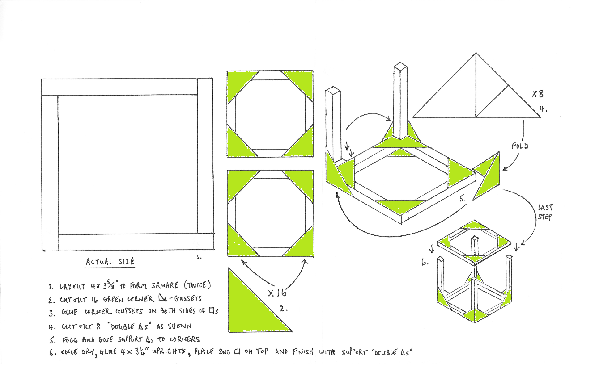
Making the cube

Slide 9
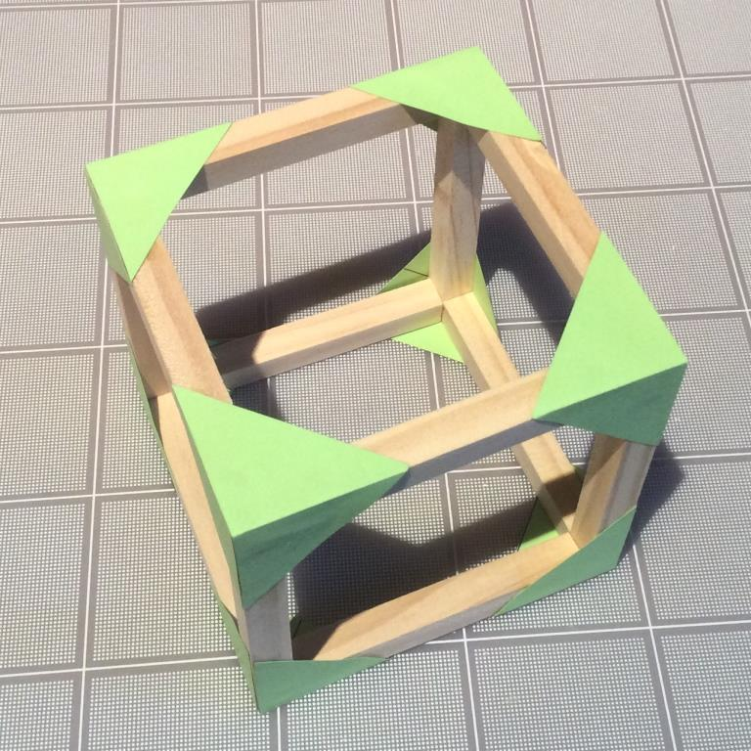
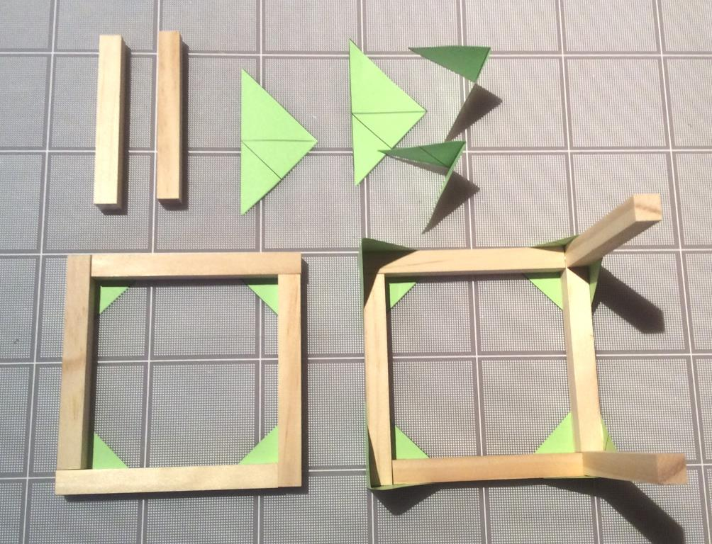
USE DOUBLE GUSSET

Slide 10
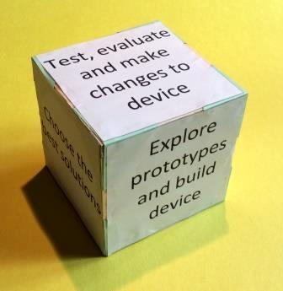
Glue the sides on the Cube

Slide 11
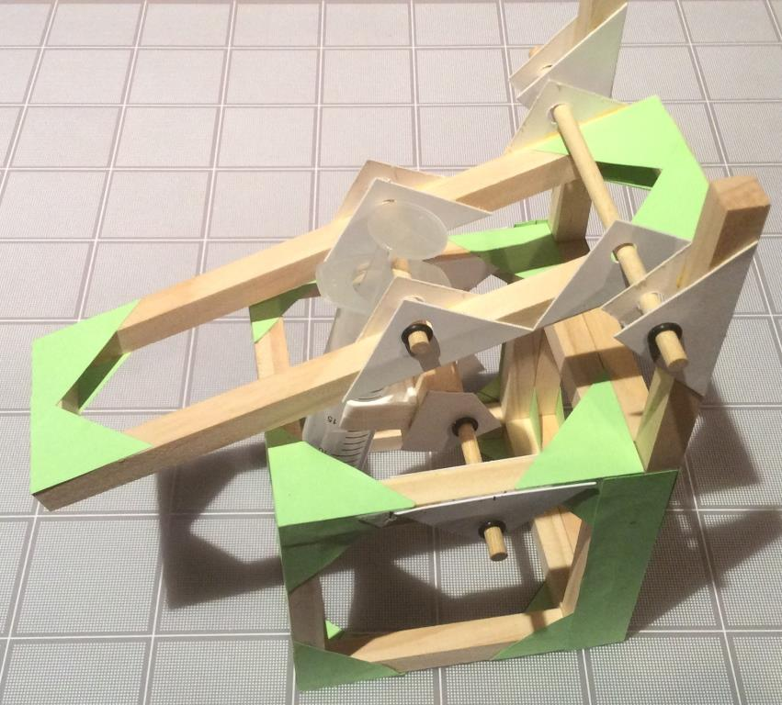
Build the Lifter

Slide 12
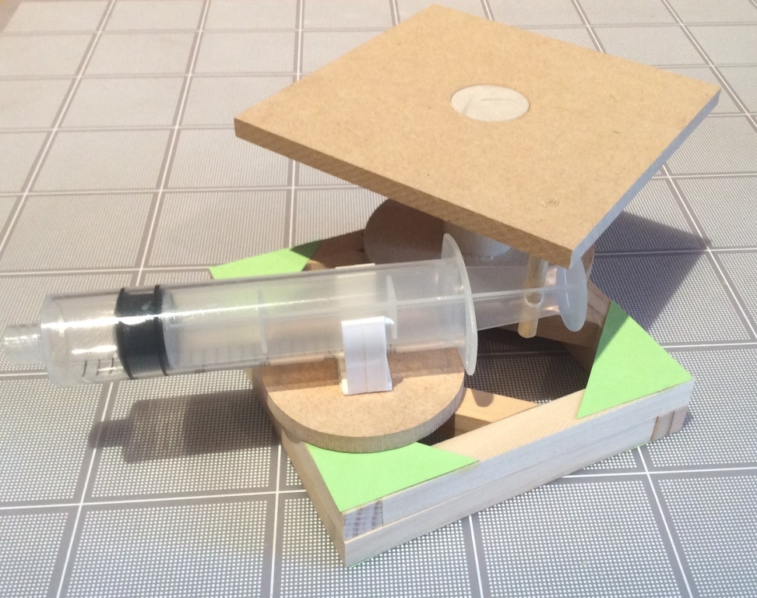
Build the Rotating Platform

Slide 13
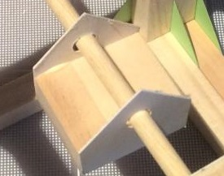
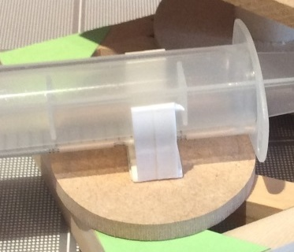
Using the piston-syringe clips
The #1 reason why devices fail is because the clips are not fixed correctly to the device. A platform must be used to accommodate movement and the clips must be secure. Use the gray clips where a greater resisting force is required. Locate the clips first before fixing them to the device. Using hot glue is not a good alternative.

Slide 14
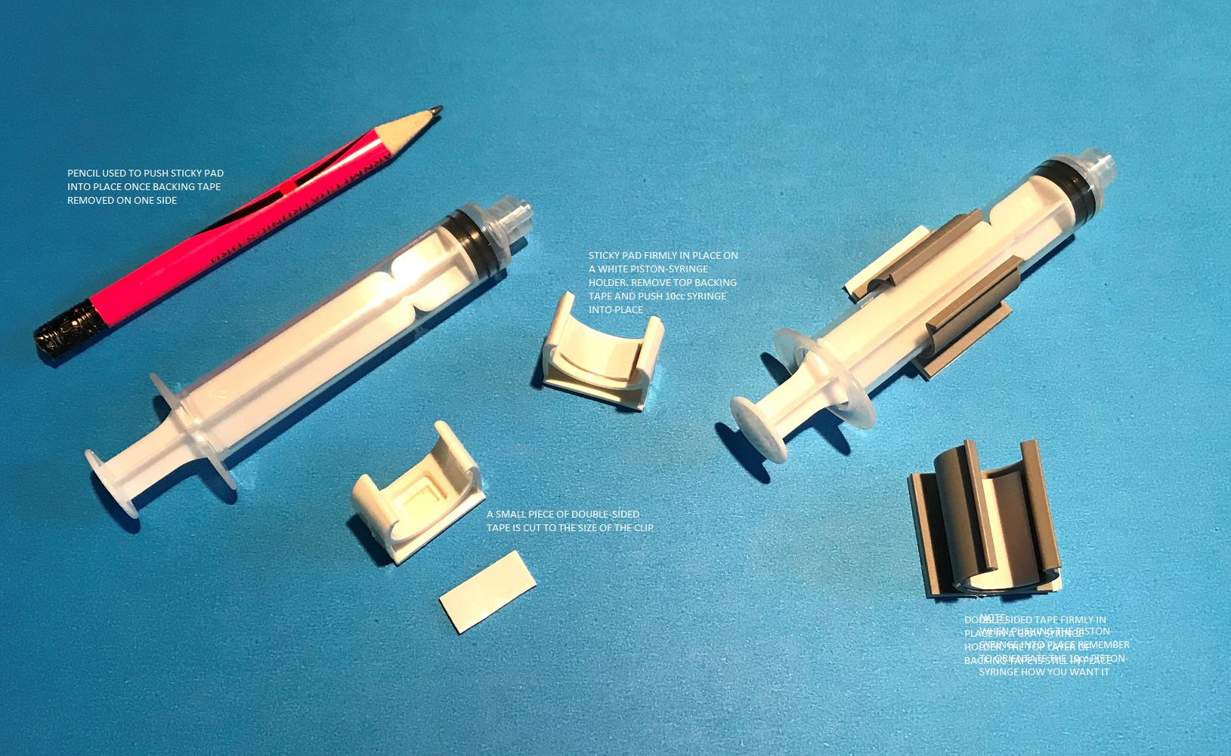
Connecting the 10cc piston-syringe to white and gray clips
For gray clips use a piece of double-sided tape cut to the size of the clip. Peel off one (1) side of the tape and insert firmly into clip.
Alternatively use the smaller white clips provided. NOTE: one of the 10cc piston-syringes has a hole in the plunger.

Slide 15
REVIEW THE FOLLOWING DOCUMENTS:
Rules for Challenge Day
The Current Challenge
Challenge Rubric
Portfolio Checklist
Portfolio Template
Isometric/Orthographic Drawings

Slide 16
The Challenge – Portfolio Rubric
 | Criteria | Points
Portfolio Rubric Contents to include: Total possible points - 45 | A detailed outline of each team member’s participation in the production of the portfolio and planned production of the device At least 3 illustrations of initial design concepts of possible device Materials used to build prototype from the Workshop Kit including dimensions Description of the use of the principles of a strong and stable structure Rationale used to decide on the type of fluid power used and where to place the piston-syringes Isometric drawing of a portion of the prototype Orthographic drawings showing dimensions and construction notes List of alternatives materials that would have been useful with reasons why Evaluation of prototype including the conclusions from making it | 0-5 0-5 0-5 0-5 0-5 0-5 0-5 0-5 0-5

Slide 17
MAXIMISE YOUR TEAM’S PORTFOLIO POINTS (45 Available)
A detailed outline of each team member’s participation in the production of the portfolio and planned production of the device
Think about your team – who is good at what?
Think about how long you have to design and build your prototype and record the process in your portfolio
At least 3 illustrations of initial design concepts of possible device
Detail helps you think about the connecting parts!
A list of materials used from the Workshop Kit including dimensions
Record the parts you use and their dimensions (important!)
List of alternative materials that would have been useful with reasons why they would have been so
This is asking you to think “outside the box” literally

Slide 18
Structural Strength
Weight
Glue
Weight
Option #1
Option #2
GROUND
Which Option is a more structurally sound Design? -- Why?
What else can go wrong and how do we improve it?

Slide 19
Structural Strength
Paper
Gussets
Wooden
Cross Brace
Weight
Weight
Force
Force
Option #1
Option #2
GROUND
Observations? Pro’s and Con’s of each option?
Reasons to use one option vs another? Other Considerations?

Slide 20
Structural Stability
Load
2lb
Pivot Shaft
Arm
1lb
Base
½lb
GROUND
Any concerns with this structure?

Slide 21
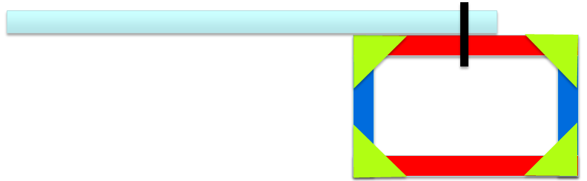
Structural Stability
GROUND
The device will tip over - Why?
How do we prevent this?

Slide 22
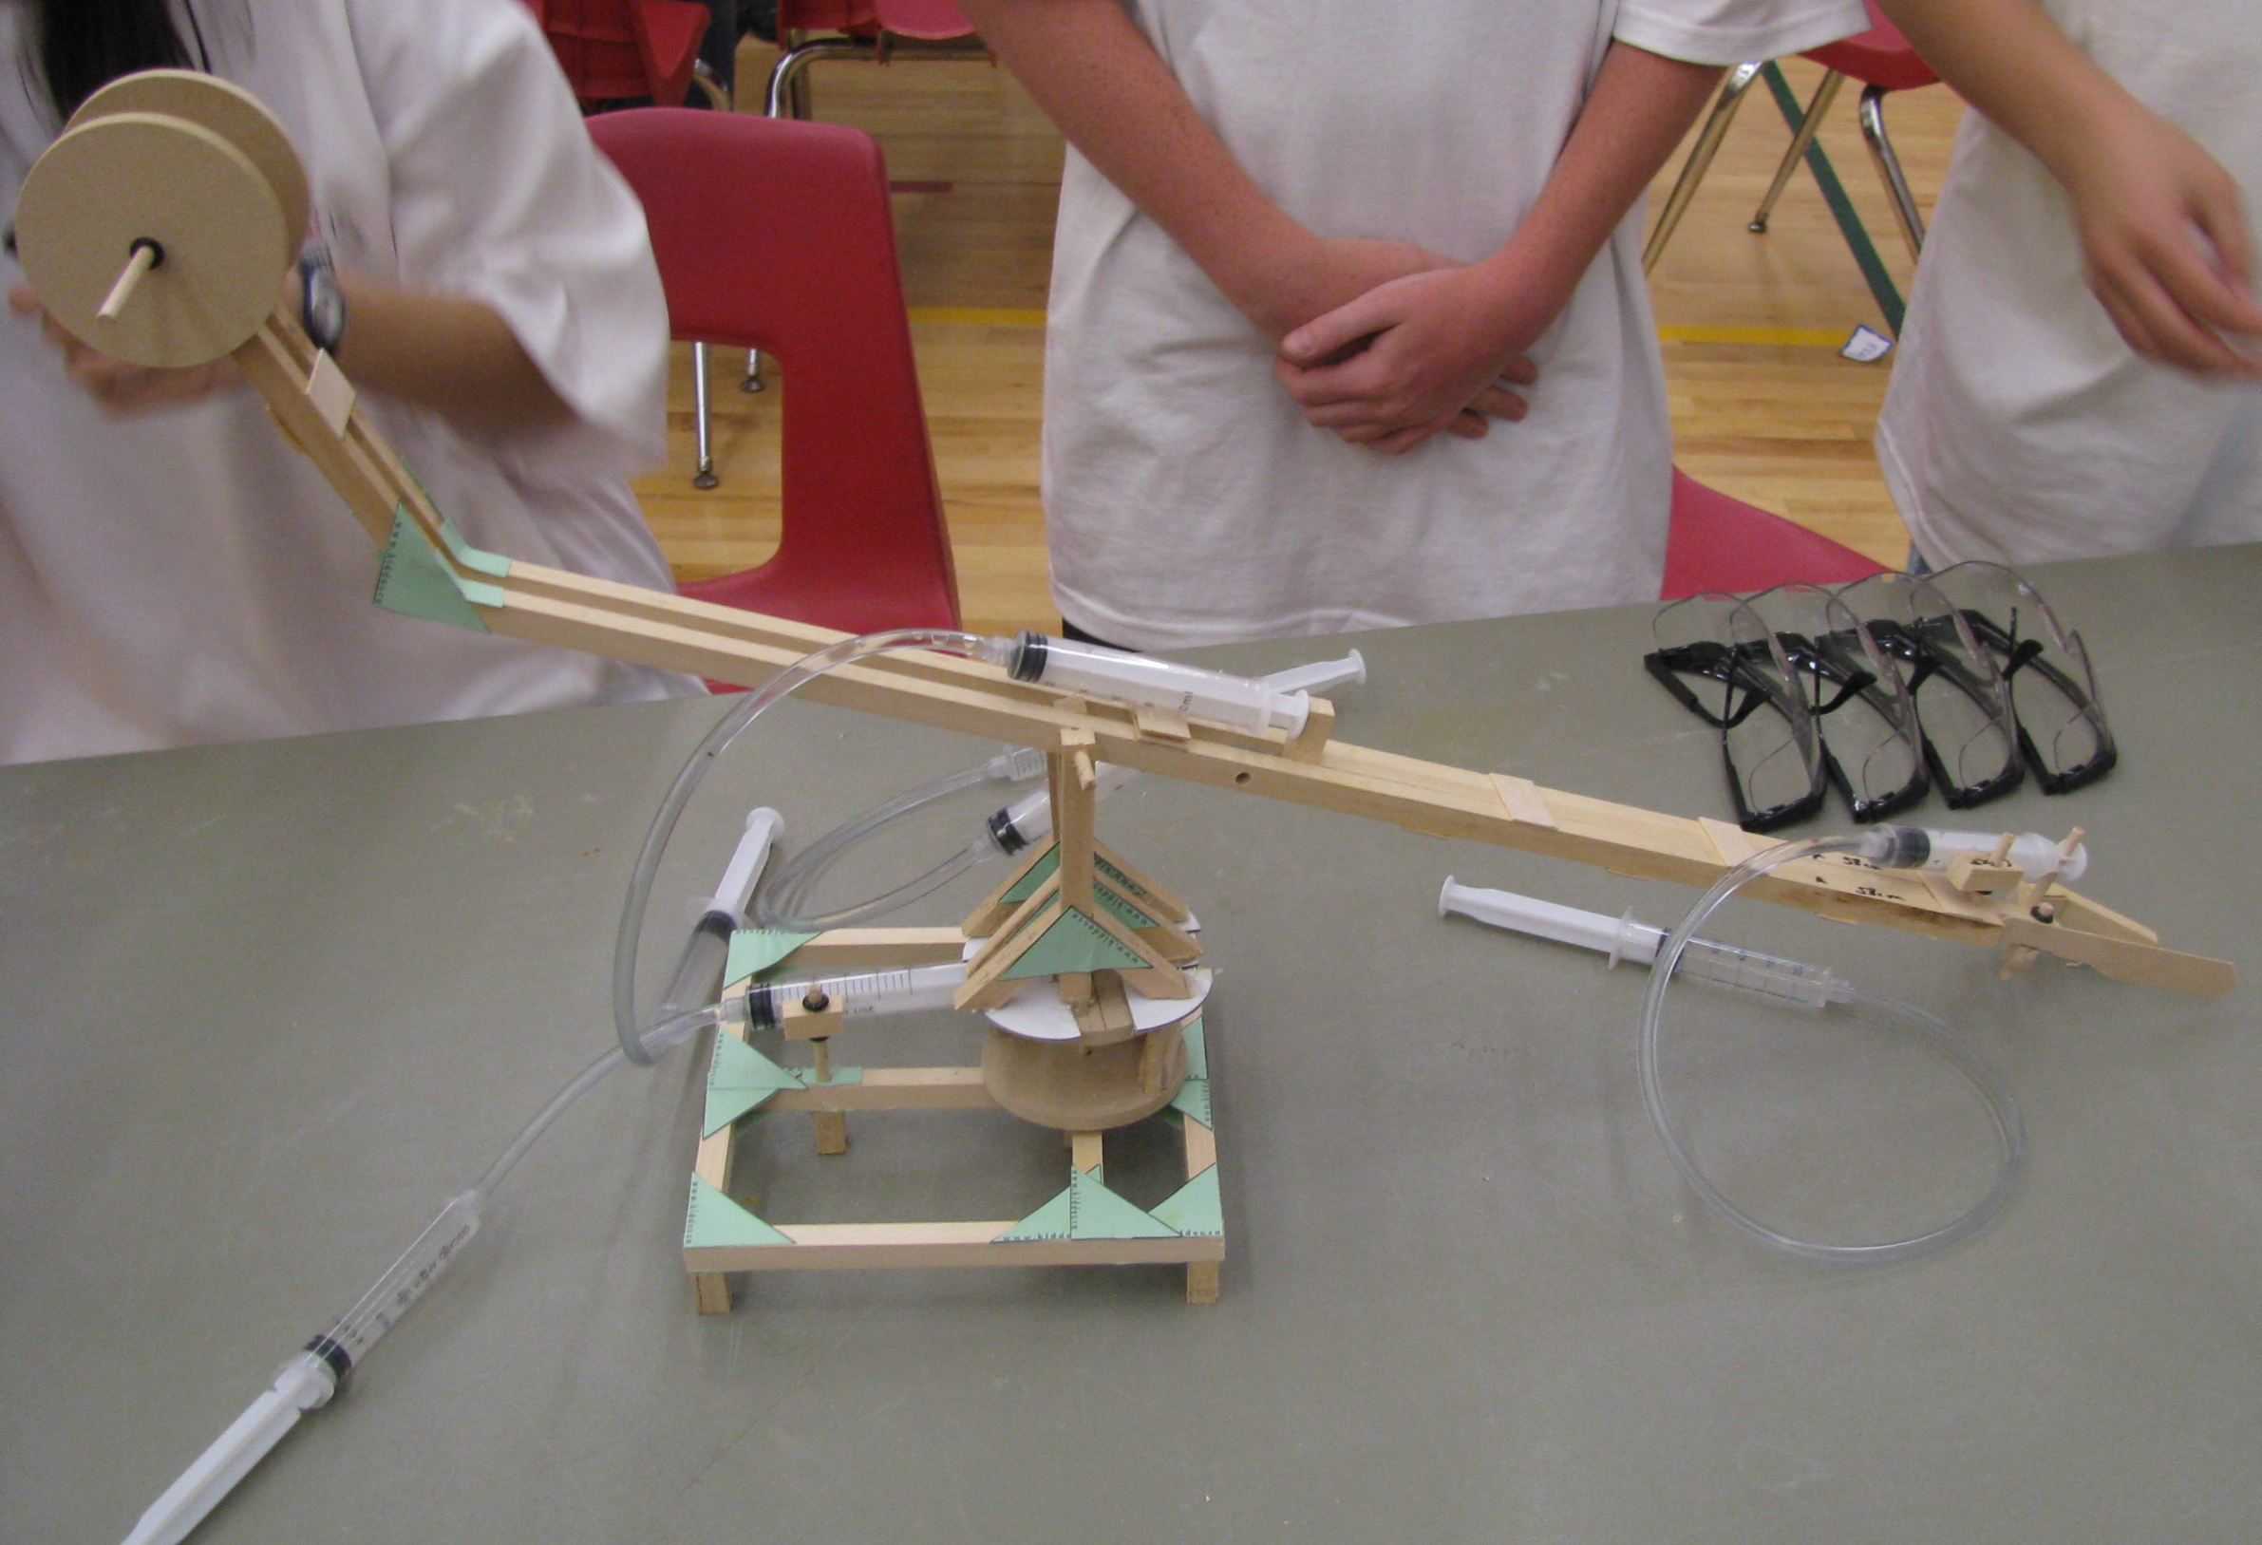
Placement of Hydraulic or Pneumatic Systems
Rationale used to decide on the type of fluid power used and where to place the piston-syringes. This device is an elegant design where the actuating pistons (the pistons that attach to the device) are efficiently placed so as to maximize movement

Slide 23
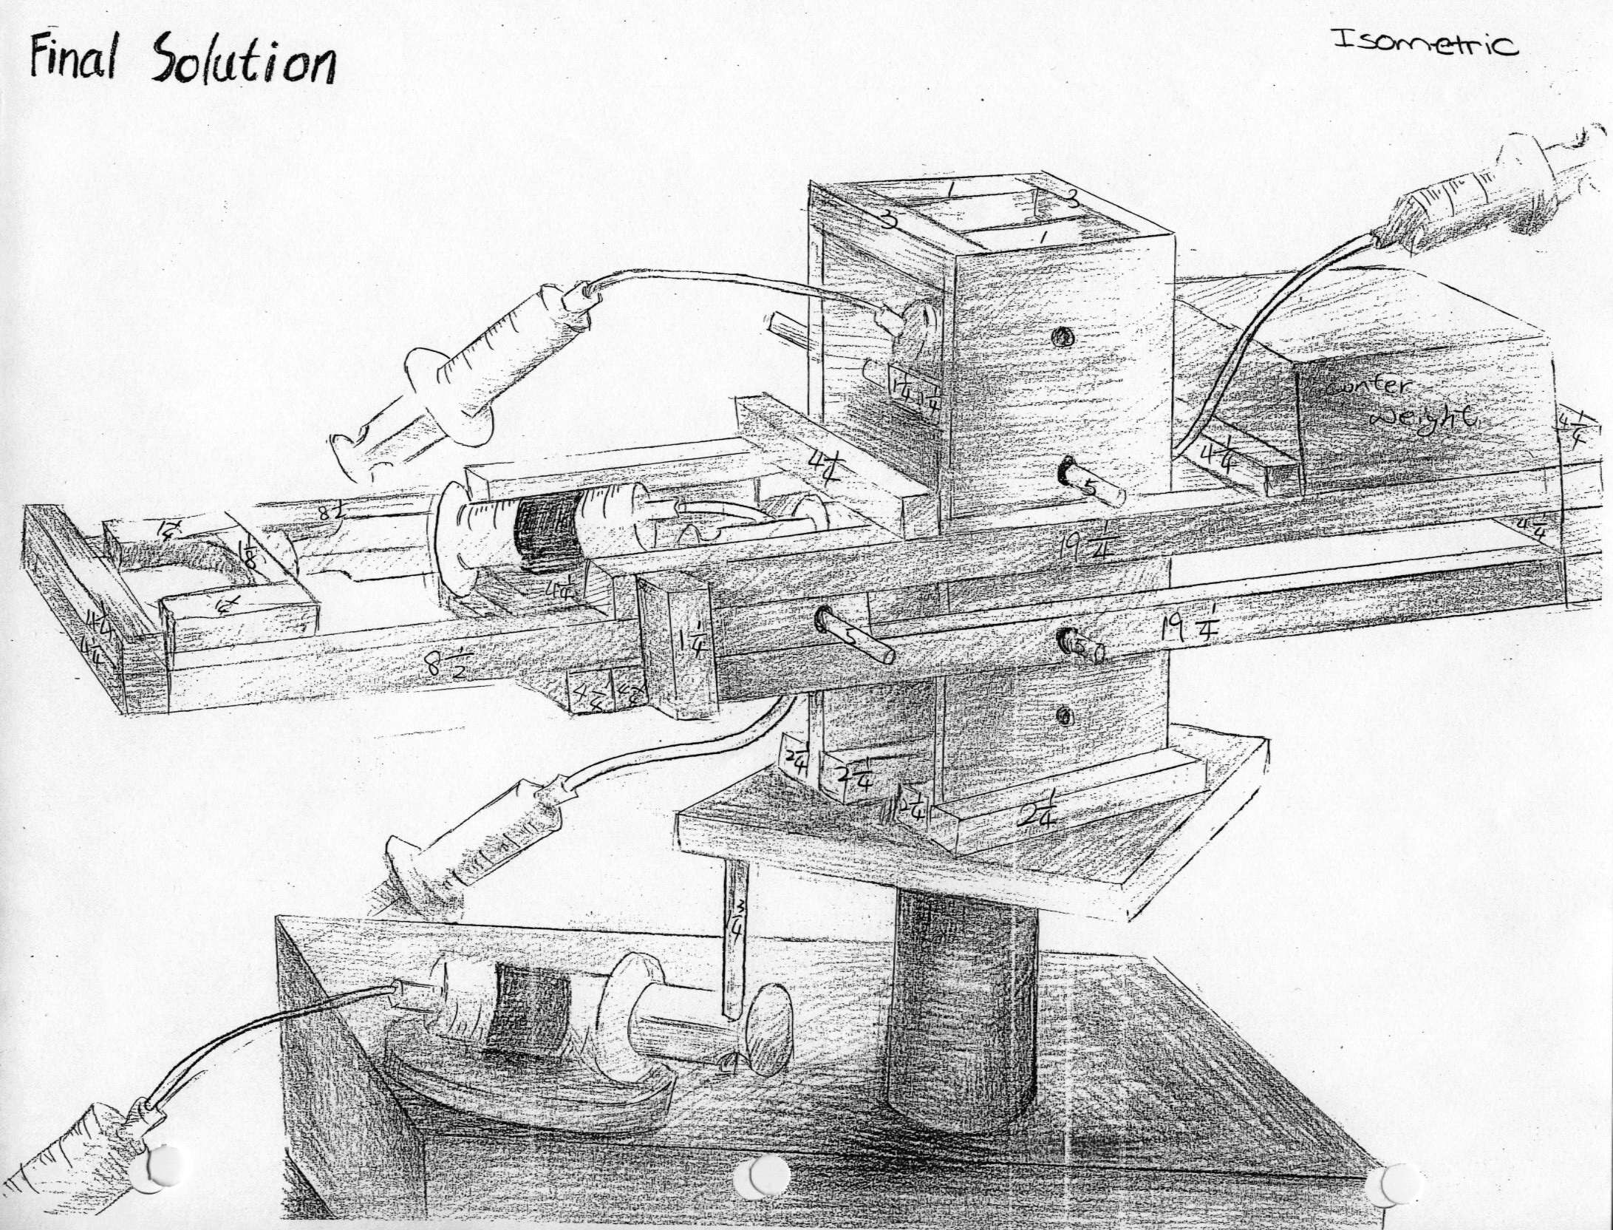

Slide 24
Orthographic & Isometric Lesson
Curriculum
  Plot Frame Criteria & Purpose
  Orthographic View Creation & Methods
  Isometric View Creation & Methods
  Hidden Lines & How They Are Used
  Practice Exercises

Slide 25
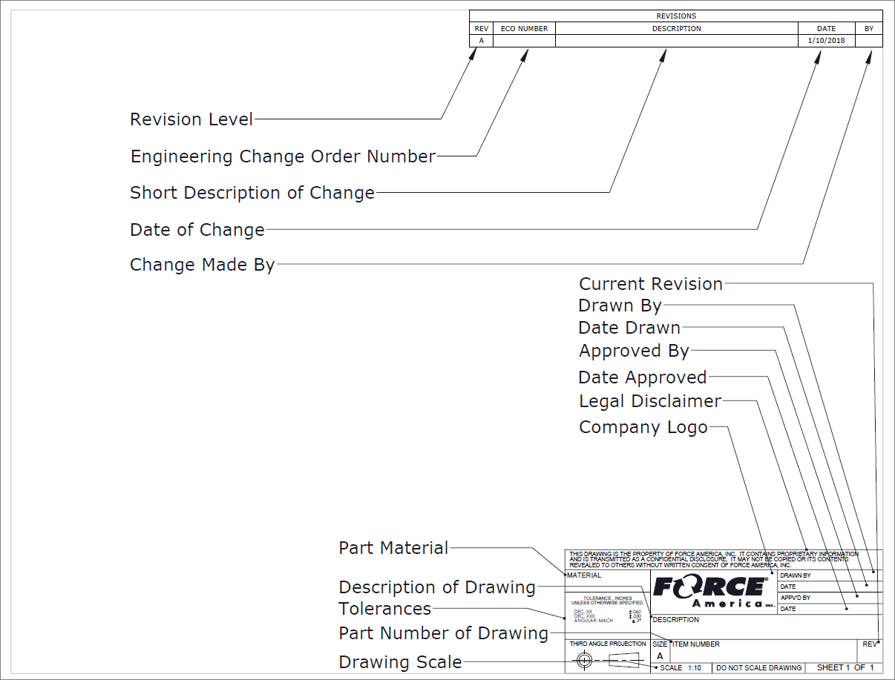
Plot Frame Criteria

Slide 26
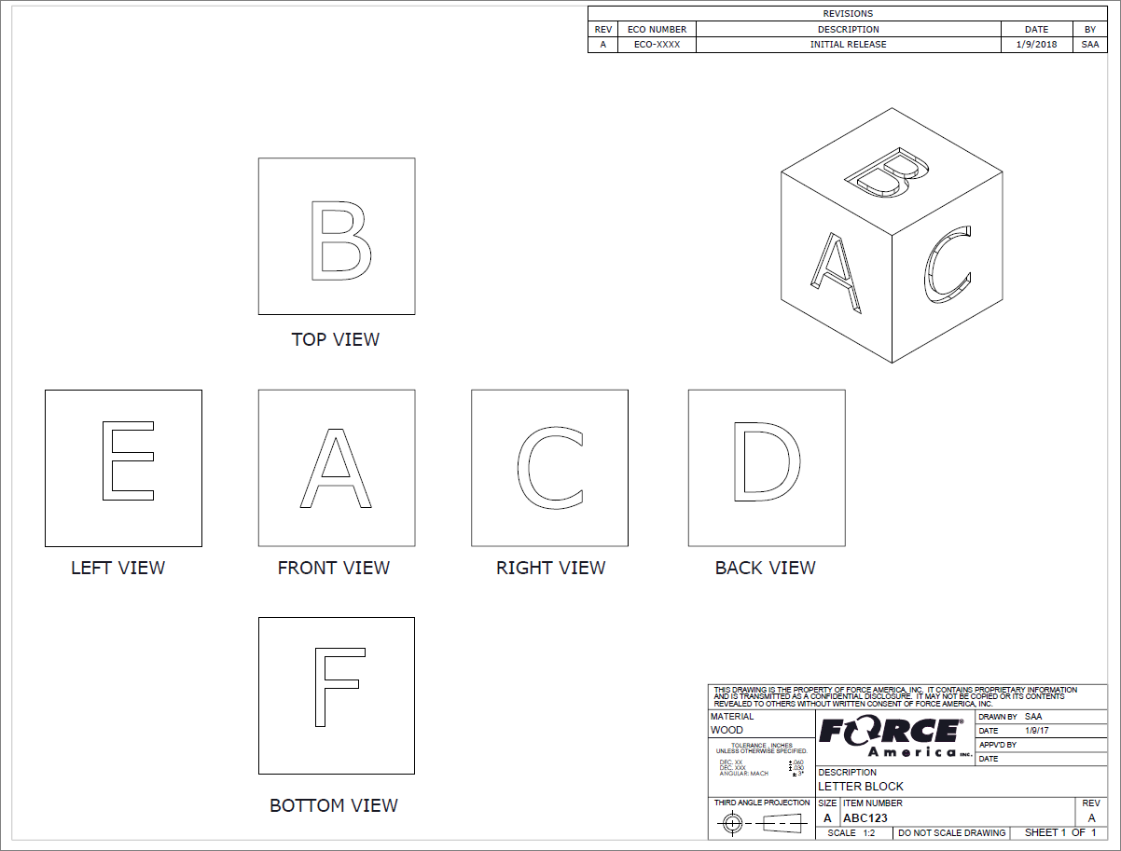
Orthographic Projection
Orthographic means single view. Each of the 6 images is an orthographic projection of a different side. Most drawings will only show the necessary amount of sides with the minimum being 3.

Slide 27
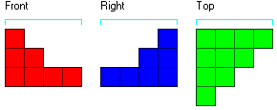
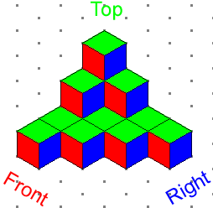
Orthographic Projection for Project
Orthographic Projection
Isometric View

Slide 28
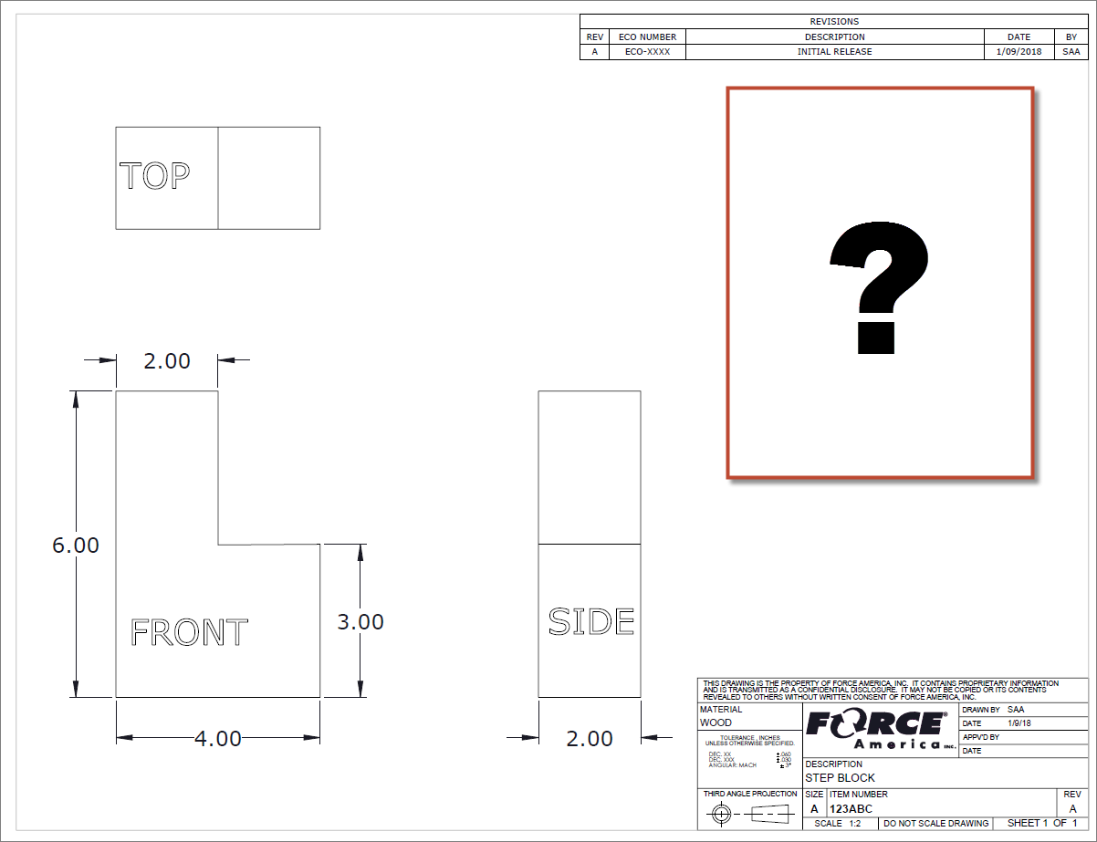
Orthographic Drawing

Slide 29
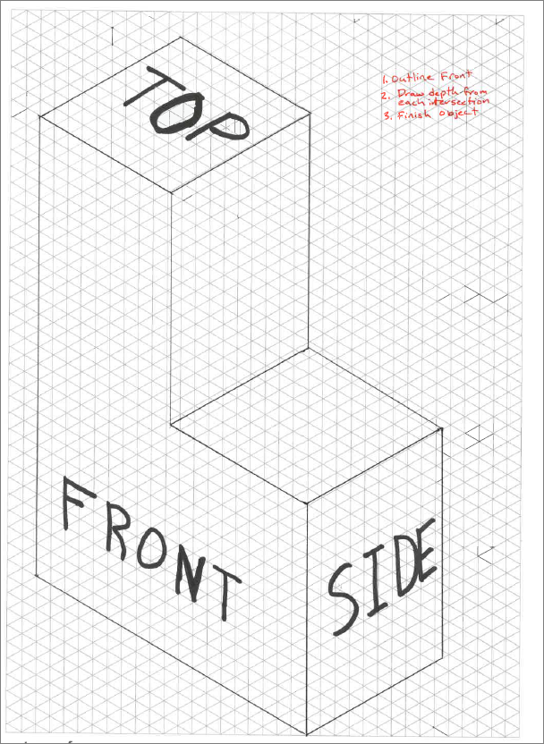
Isometric View
Always use Isometric Paper & Pencil, as corrections are very common
Draw Front using the appropriate 30 degree direction on your paper.
Draw either the side or top depth going 90 degrees from Front.
Finish your drawing by closing all of the sections.

Slide 30
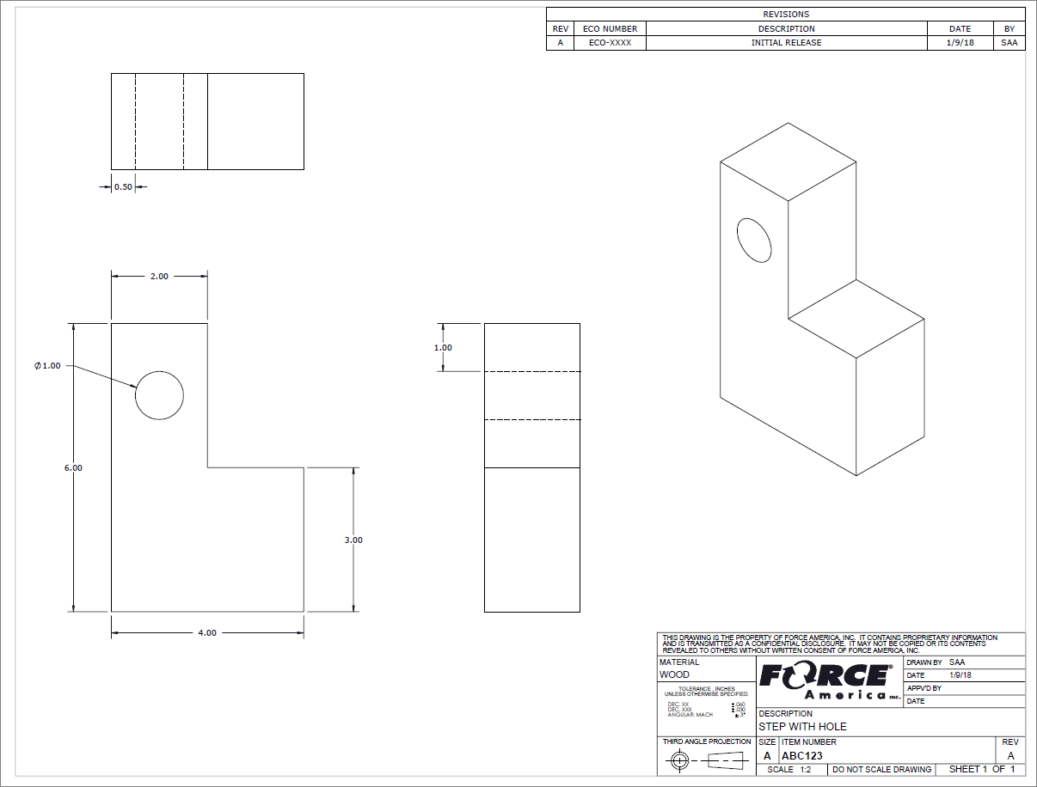
Hidden Lines
Dashed lines are used to define something that is underneath a solid object.

Slide 31
Orthographic & Isometric Recap
Drawings should have enough defining information listed
Orthographic projections shows 2D view of a specific side and should line up as if the item was being unfolded
Isometric shows a 30 degree offset view
Hidden lines are dashed lines in orthographic projections

Slide 32
The Challenge - Teamwork & Work Habits
The Challenge relies on teamwork to be successful
Successful teams:
  Work together according to a time-line
  Assign & divide tasks
  Plan their work & work their plan
  Complete tasks in parallel
  Leverage individuals' strengths
  Don’t mess with other Teams materials without permission

Slide 33
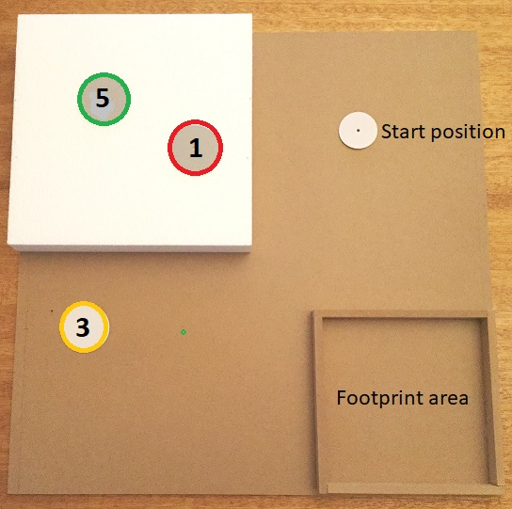
This is the 2021 Challenge layout board. Your team must build a device that sits in the footprint area and moves a wooden cylinder from the start position to any one of three target disks. An object placed upright on a target is worth 5, 3 or 1 point according to its location. The task is to accumulate as many points as possible in two minutes

Slide 34
Discussion
Why is one destination position worth more points than the other?
What if you design a device that only works when using your hands?
How long will you have to move objects?
What tools/materials can you use to build your device on the Challenge Day?
Why is the Portfolio so important?

Slide 35
The Challenge Process
Objective
To design a device using only the supplied tools and materials, that can score as many points as possible.
Deliverable
Two copies of the portfolio
Challenge Kit
On the Challenge Day your team will bring your portfolio and tools. A Challenge Kit will be provided. It contains all the materials you will use including an extra gray piston syringe holder, two extra 20cc syringes and 6ft. of extra tubing

Slide 36
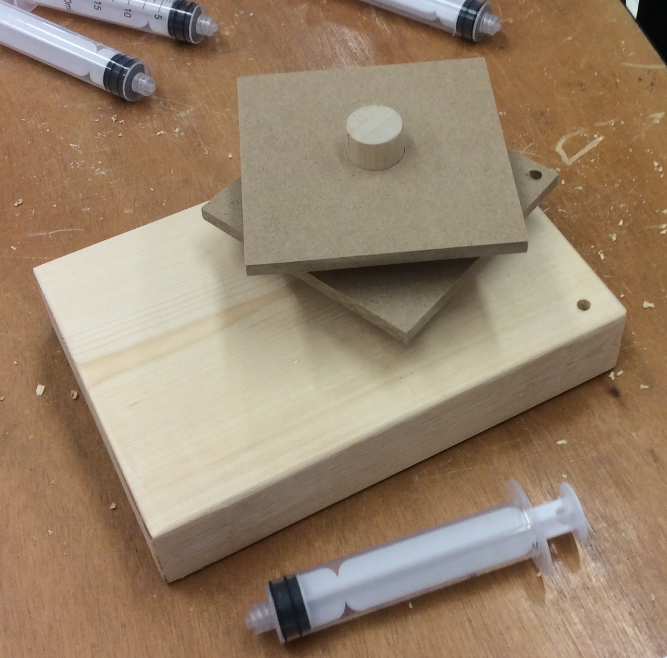
The Workshop kit and the Challenge Day kit contain a large wooden base with a hole in it to accommodate a large diameter dowel found in the kits. This can be used as a stable base if your team decides to do so. The hole is off-center and the dowel may require sanding to fit as your team wants.
The large dowel fits the two platforms in the kit. The picture shows that this team decided to drill a hole in the lower platform for a dowel and another hole in the base presumably for a rotating wheel with a piston holder fixed to it – an arrangement demonstrated by the Workshop Rotating Platform kit.

Slide 37
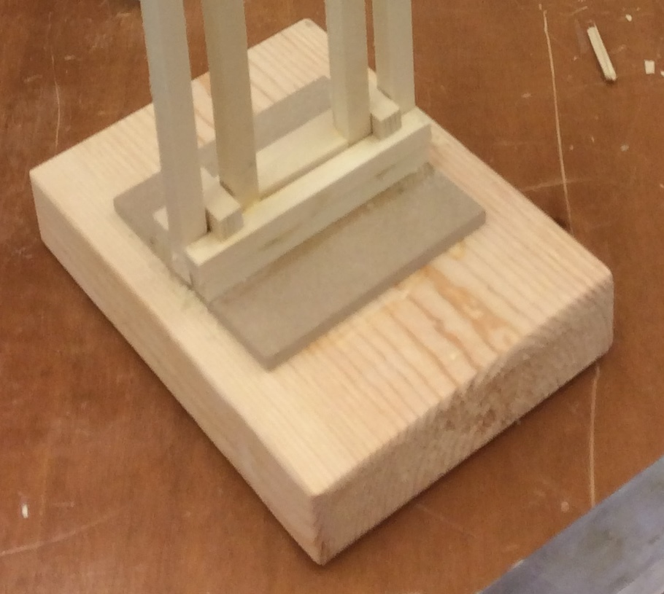
In this picture the large wooden base was used in a different way – there is no large dowel involved and a fixed structure is being built upon it

Slide 38
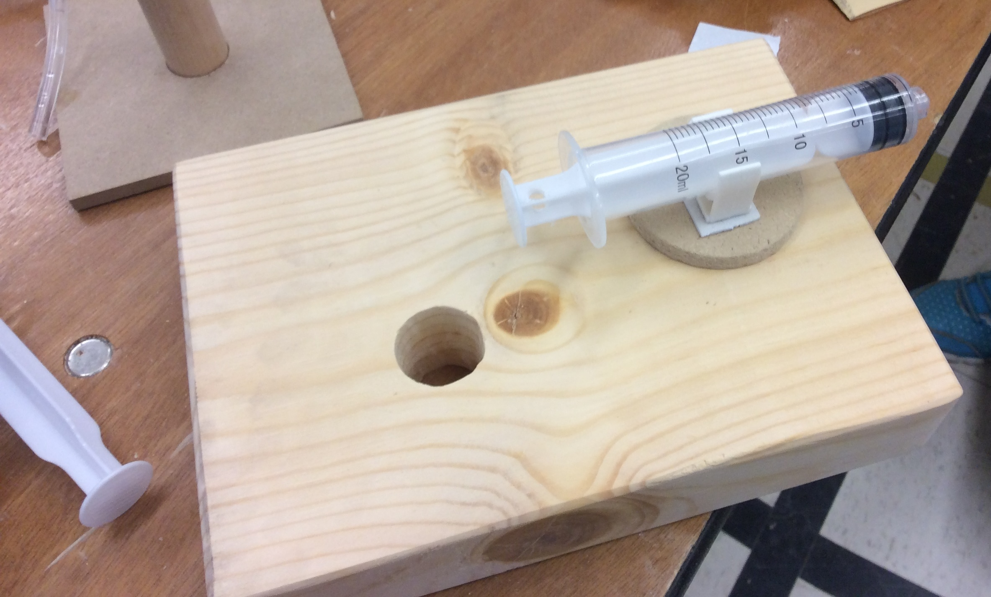
The Workshop kit and the Challenge kit both contain syringe holders. It has a “one-time” sticky pad on its base and must be pushed firmly onto a paper, plastic or a wooden surface to adhere sufficiently to hold the 20cc or 10cc piston syringe in place. A double-sided sticky pad can be used with it if a larger area is required.
Wood glue and hot glue are NOT efficient ways to secure a syringe holder
The arrangement in the picture above may have potential problems. Why?

Slide 39
SAFETY is our number #1 concern
ALL motion must be controlled by fluid power
USE your materials wisely
DOCUMENT everything in your portfolio
All materials to build device are provided
Bring tools
Use your time efficiently
Have fun and work well

Slide 40
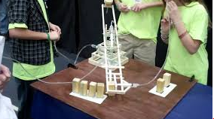
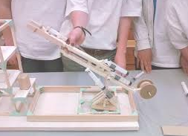
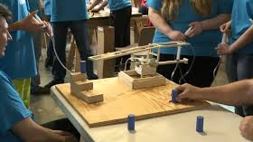
Examples of previous projects
YouTube & Google
“Fluid Power Action Challenge”
Challenge Video 2
Challenge Video 3
Notes:
https://www.youtube.com/user/NatlFluidPowerAssn

Slide 41
The Portfolio Review Template and Checklist
The Portfolio Review Template is considered the minimum requirement for your team’s portfolio.
The Checklist is a sample Index for your Portfolio
See sample Portfolio on Resources Center:
http://nfpahub.com/fpc/resources/#!/event/25

Slide 42
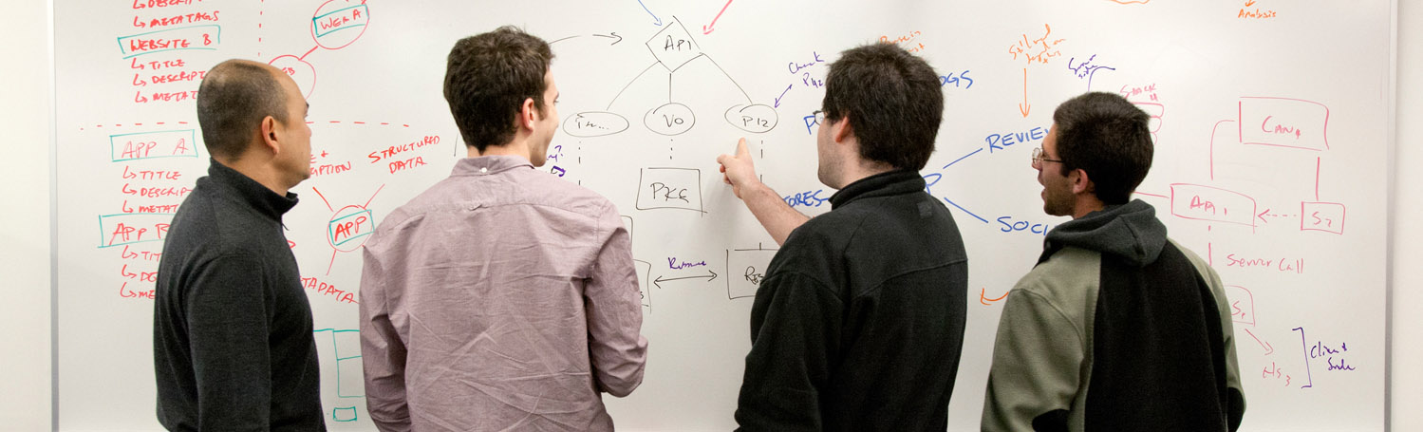
Sketching is a way of communicating ideas

Slide 43
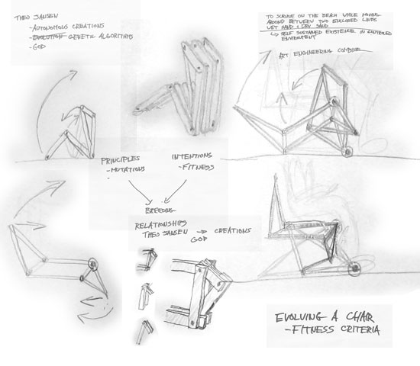
Sketching is a way to explore new ideas.
Notes:
Fast way to explore options – sketch it first, always

Slide 44
Examples of team tasks:
Read project rules
Research clamping mechanisms
Sketch ideas for clamping mechanisms
Research rotating mechanisms
Sketch ideas for rotating mechanisms
Research rotating mechanisms
Build prototype mechanisms
Sketch whole robot design
Build a whole prototype
Practice challenge activity
Read portfolio scoring rubric
Generate final sketches of design for portfolio
Write a description of the principles of strength and stability
Write an explanation of the chosen location of your syringes
Have writing reviewed by a mentor
Assemble all portfolio elements into a final report
Who will be responsible for what?

Slide 45

Identify concrete tasks and milestones
Read rules and scoring rubrics
Build prototype rotating mechanism
Have draft portfolio reviewed by a mentor
Milestone:
Assemble writings and sketches into final portfolio
Milestone:
Finalize robot design
Research clamping mechanisms

Slide 46



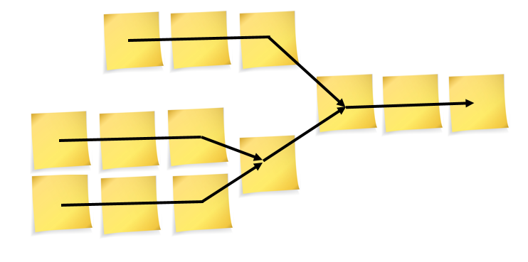
What you should be doing right now
Identify 3 tasks or milestones
Lay out the schedule
Choose dates for your milestones

Slide 47
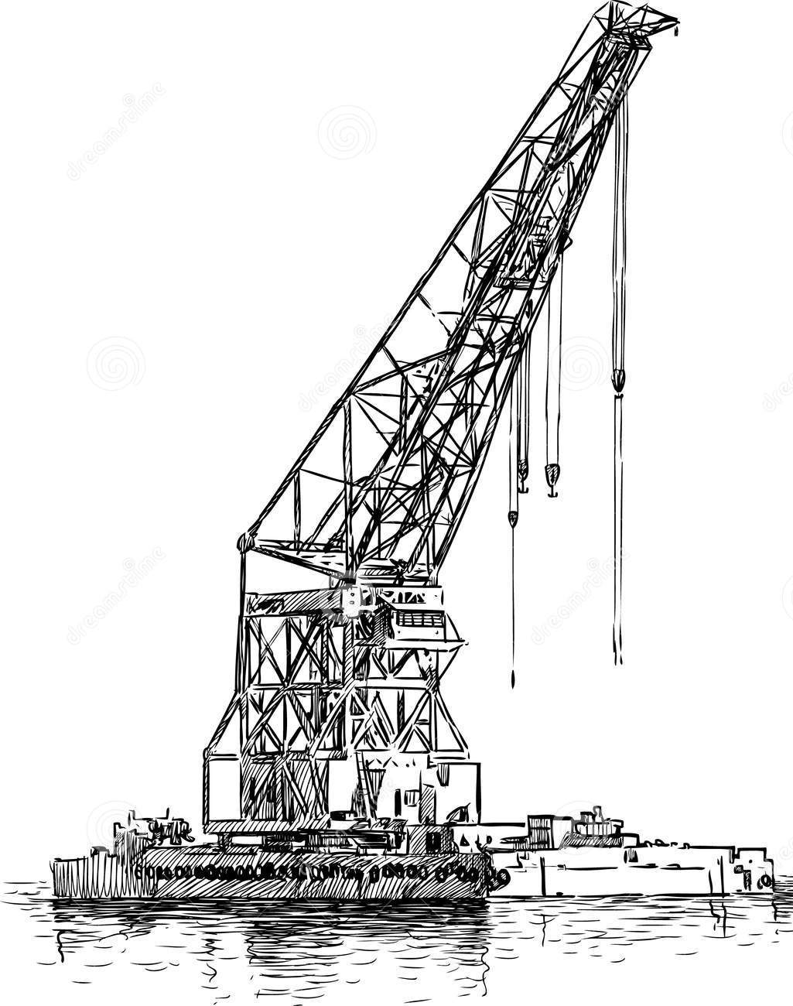
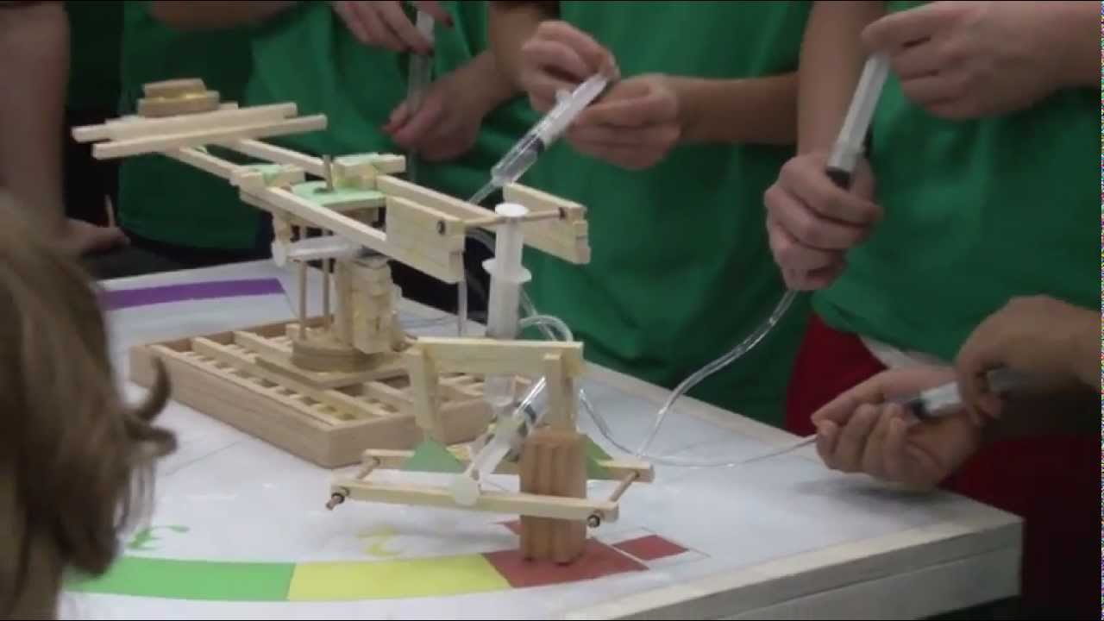
Watch videos from previous Fluid Power Action Challenges on YouTube or Google web (“Fluid Power Action Challenge”)
Successful products are always made by carefully researching existing products.
Notes:
https://www.youtube.com/user/NatlFluidPowerAssn

Slide 48

This document was originated by:
Additional contributions by:

