Slide 1
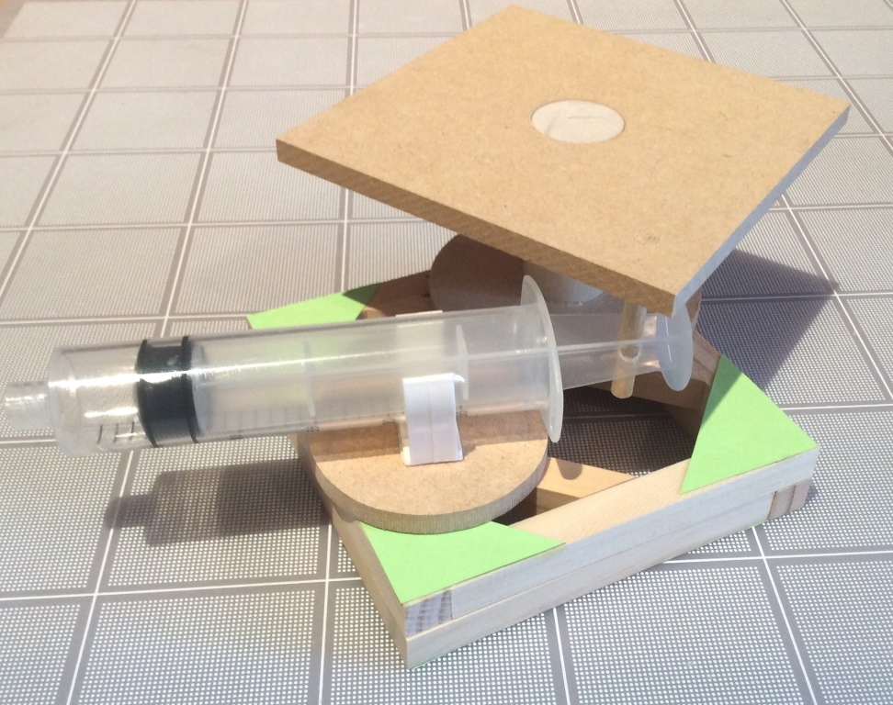
Rotating Platform
Step-by-step assembly instructions

Slide 2
Contents of Rotating Platform Kit
Wooden pieces (⅜” cross-section): 8 X 3⅝”; 2 pieces with 45° ends
Green corner gussets: 1 card
Syringes, 20cc: 2 (1 has a hole in the plunger ½” from end)
Plastic Tubing: 1 length 12”
Syringe Holder: 1
Wooden dowel, 3/16” diam.: 1 X 1¾”; 1 X ⅞”
Wooden dowel, ⅞” diam. 1 X 2⅞”
Large wheel, with ⅞” hole X 1, Medium wheel X 1
4” Square Platform with ⅞” & 3/16” holes
Plus a small piece of sandpaper

Slide 3
Make two squares using the eight 3⅝” pieces. To join the pieces of wood together use green triangles on one side only and a small amount of wood glue on each triangle. Also glue the two other pieces into one of the frames as shown

Slide 4
Glue the larger dowel into the center hole of the platform and the longer small dowel into the corner hole of the platform. Glue the other small dowel into the wheel

Slide 5
When the frames are dry glue them together. Apply glue to the sides without the green corners. The frame with the extra pieces goes on the top

Slide 6
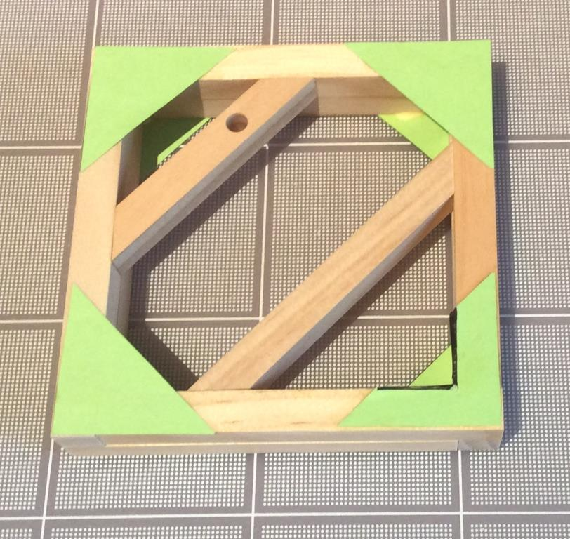
Cut out part of the green card on the top frame in one corner (the 90 °corner of the largest triangle)

Slide 7
Glue the large wheel onto the frame as shown. Make sure the ⅞” diameter dowel that is attached to the platform rotates freely in the hole of the large wheel.

Slide 8
Attach the plunger of the syringe with hole in it to the platform

Slide 9
Strip off the backing from the white clip and firmly press it onto the centre of the wheel

Slide 10
Assemble the model as shown and then push the tubing onto the syringe. To operate the platform attach the other syringe, with its plunger in, onto the tubing and then pull its plunger out.

Slide 11
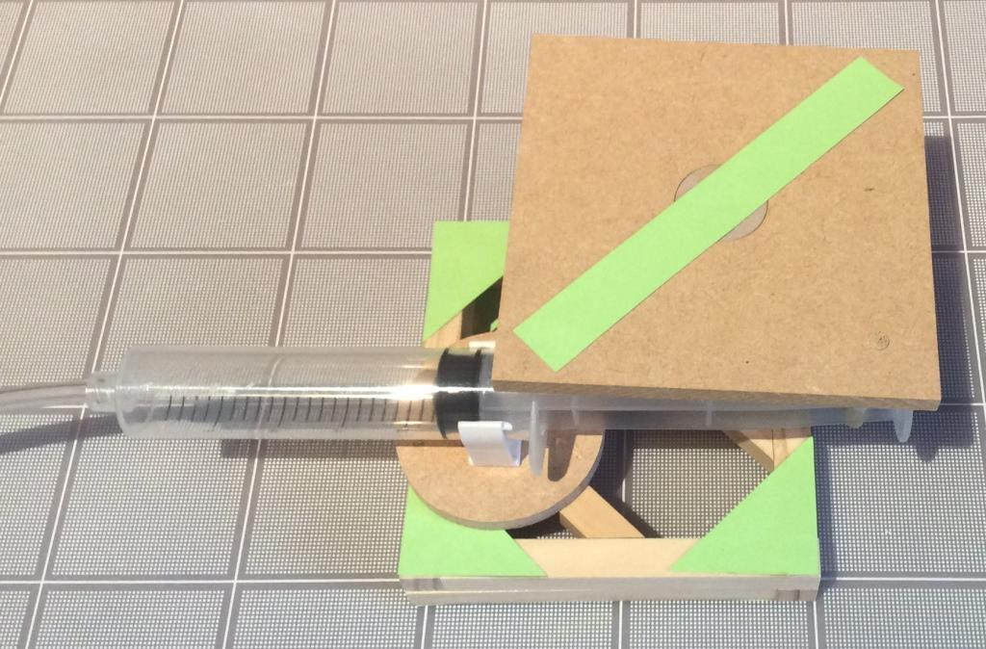
Glue a piece of card stock onto the top of the platform to measure rotation The platform will rotate approximately 80° when the system operates. Note that the wheel with the syringe holder rotates as well as the platform

